Slide 1
EMERGENCY RESPONSE SYSTEM
Presented By Group Name : DEV HUSKIES Dhankuwar Sisodiya(1066439) Mayank Deshpande(1080496) Shivi Bhatt(1027605)

Slide 2
ABOUT ECOSYSTEM
The purpose of the Emergency Response System is to provide essential guidance and keep users up to date about any emergency situations. Additionally, this application also organizes and manages the resources and responsibilities of each operational unit in humanitarian emergencies in order to lessen the impact of disasters.

Slide 3
PROBLEM STATEMENT
The world today is impacted by emergencies on an unprecedented scale.The health, economic, political and societal consequences of emergencies can be devastating, both in the acute and long term. They have major impacts on the health and well-being of communities, resilience of health systems, stability of national economies, and progress towards the Sustainable Development Goals.

Slide 4
CONTINUE
Managing emergencies can be a problem especially for developing countries with lack of infrastructure. There is an over-reliance on media outlets which sometimes result in false information. There could be some critical information that does not reach immediately and there is no way to filter it out.

Slide 5
EXTRA FEATURES
Email Confirmation Sent to User
SMS Confirmation Sent to User
User can find nearest organization
User can set the location where scene has occurred.
User can set the location of the organization

Slide 6
EXTRA FEATURES
Notification Broadcasted to relevant authority for response in Three platforms
Ecosystem
SMS(Mobile Message)
Email

Slide 7
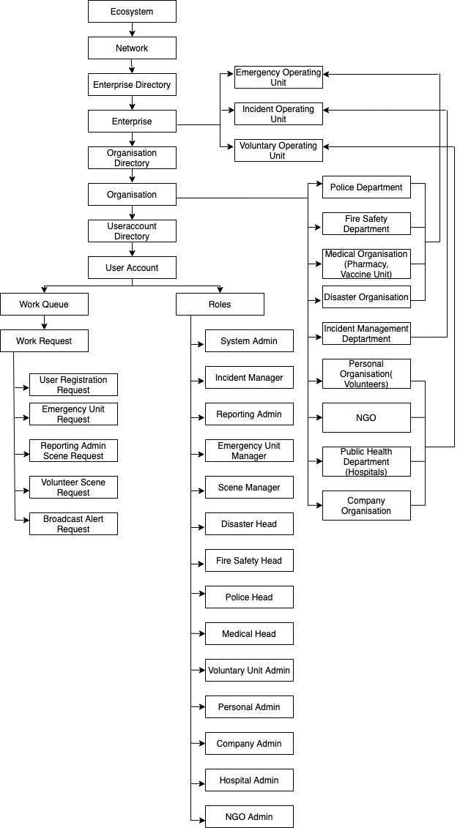
ECOSYSTEM ARCHITECTURE DIAGRAM

Slide 8
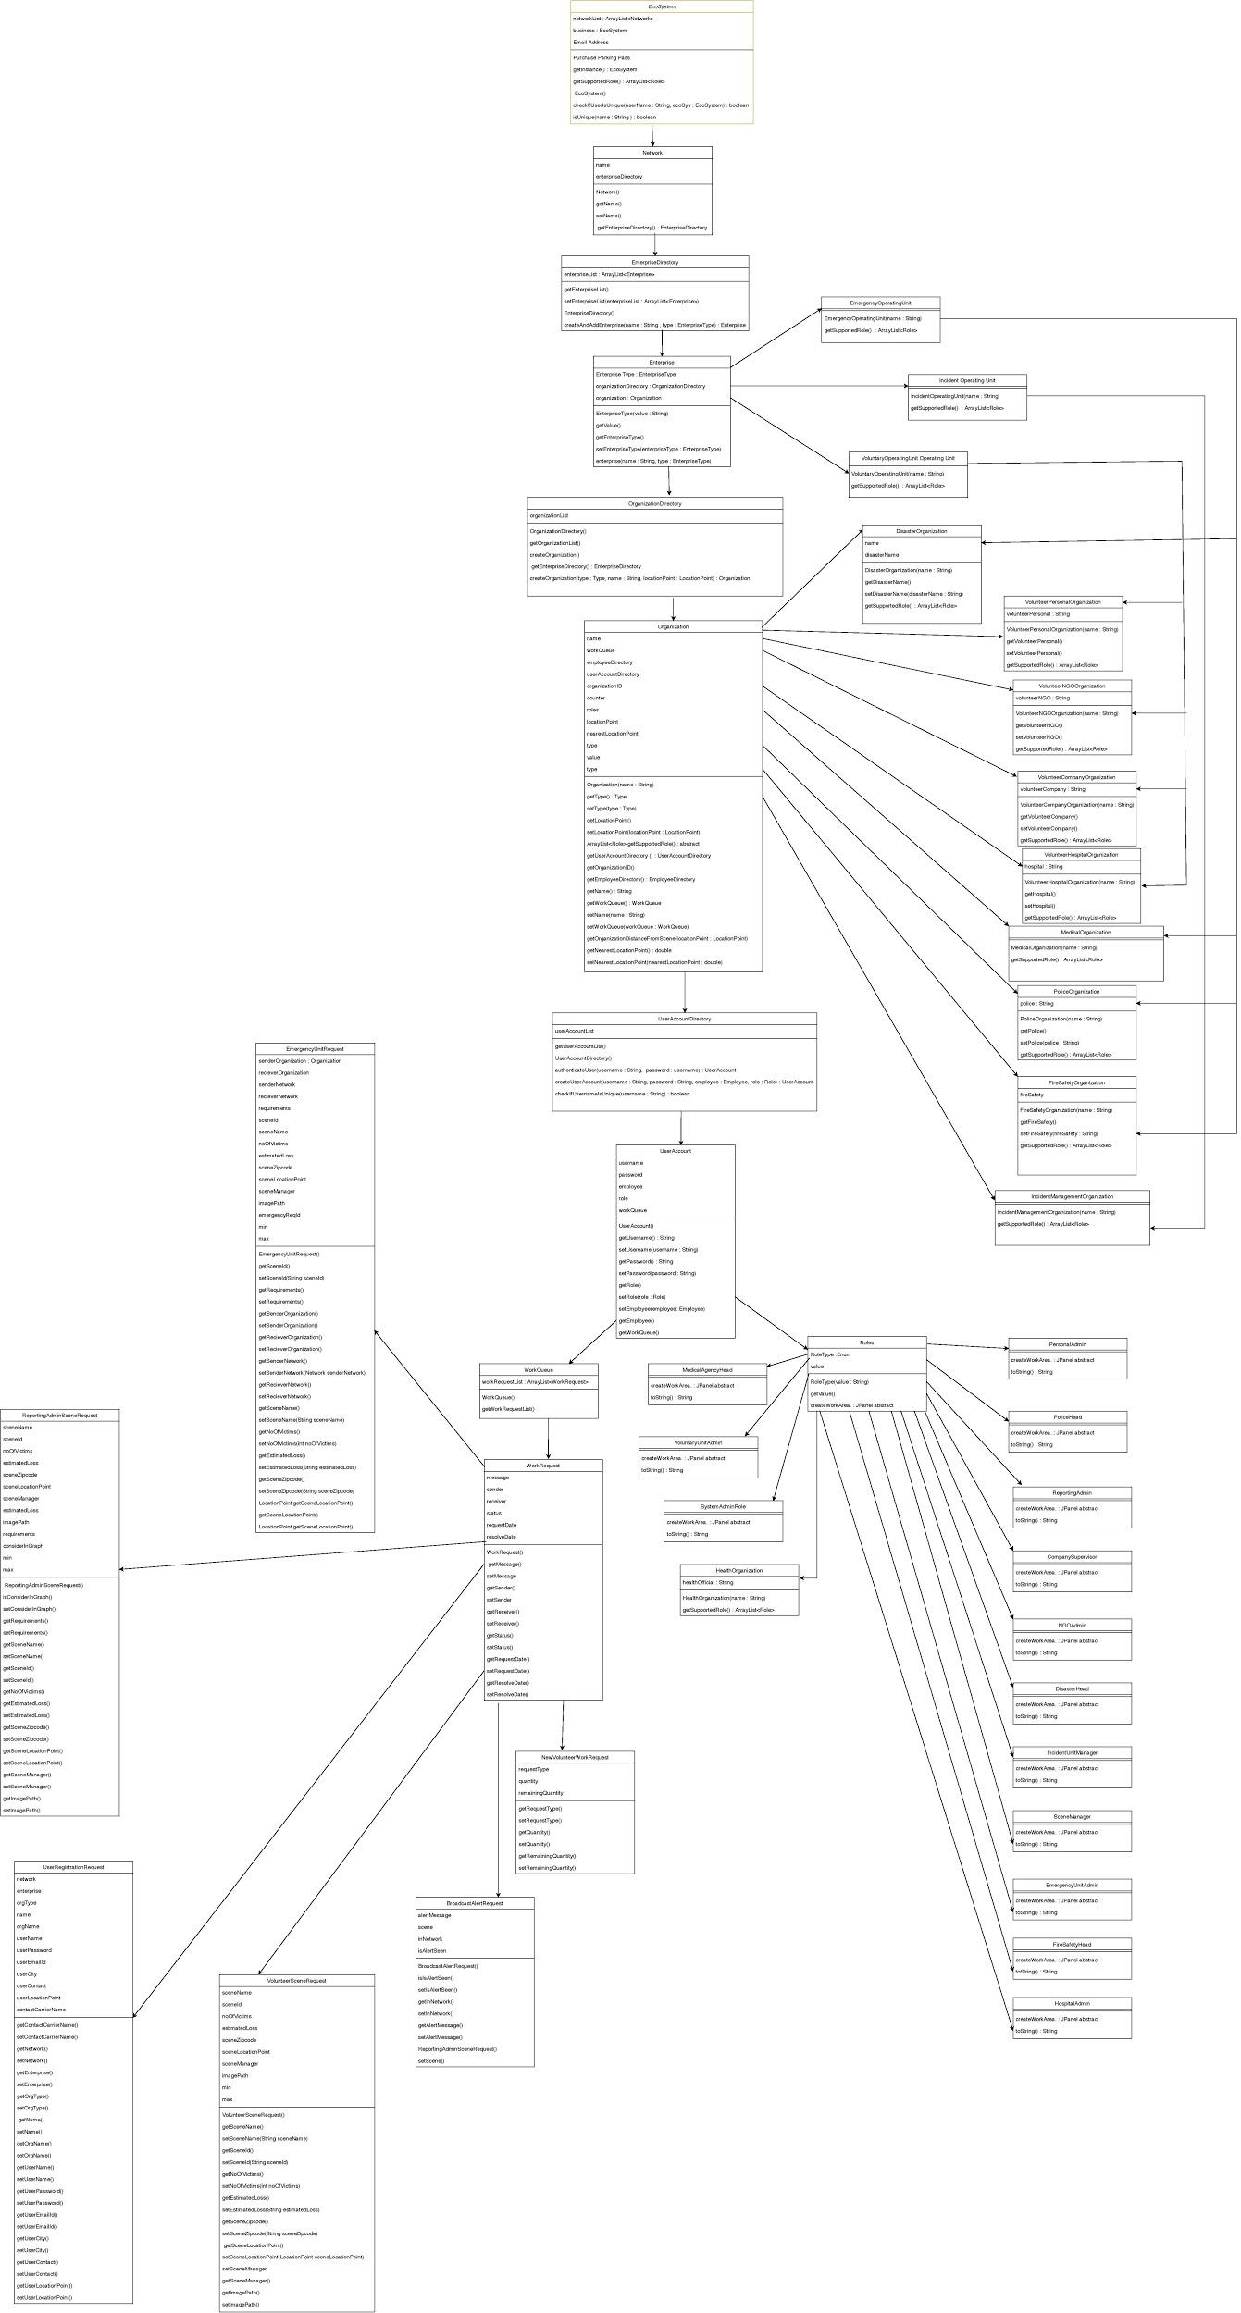
UML DIAGRAM

Slide 9
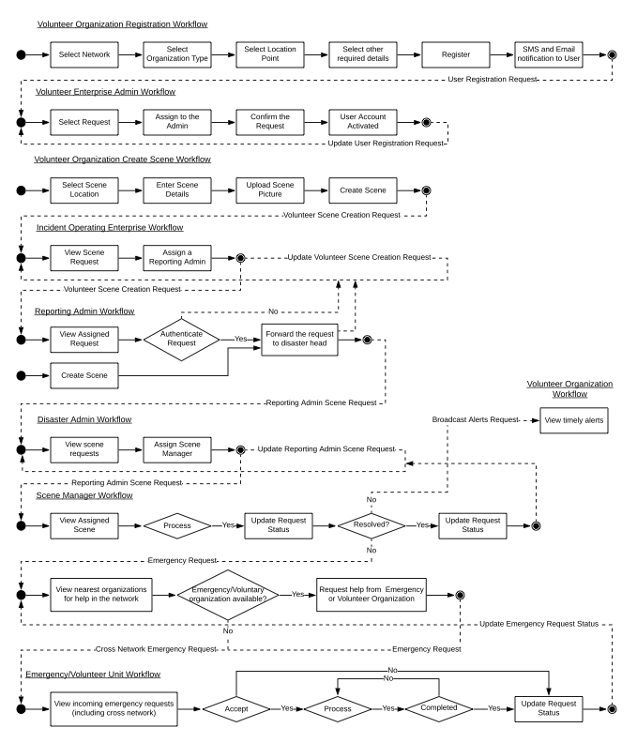
WORKFLOW

Slide 10
ROLES & CAPABILITIES
Company Supervisor
The responsibility of this role is to fulfill request in case of any emergencies.
Emergency Unit Admin
The responsibility of this role is to create emergency organizations, employees and users and set the locations for each organization.

Slide 11
ROLES & CAPABILITIES
Fire Safety Head
The responsibility of this role is to fulfill request related to fire in case of any emergencies.
Hospital Admin
The responsibility of this role is to fulfill casualties request in case of any emergencies.

Slide 12
ROLES & CAPABILITIES
Incident Unit Manager
The responsibility of this role is to assign the scene requests to the reporting admin for verification.
Medical Agency Head
The responsibility of this role is to fulfill vaccines/medical request in case of any emergencies.

Slide 13
ROLES & CAPABILITIES
Disaster Head
The responsibility of this role is to assign the approved scenes to the scene managers.
Scene Manager
The responsibility of this role is to send emergency requests to other organizations/cross network

Slide 14
ROLES AND CAPABILITIES
NGO Admin
The responsibility of this role is to fulfill help from NGO request in case of emergencies.
Personal Admin
The responsibility of this role is to fulfill request from scene manager in case of emergencies.

Slide 15
ROLES AND CAPABILITIES
Police Head
The responsibility of this role is to fulfill police requests from scene manager in case of emergencies.
Reporting Admin
The responsibility of this role is to verify the scene created by user and can also create scene in case of emergencies.

Slide 16
ROLES AND CAPABILITIES
System Admin Role
The responsibility of this role is to create enterprises, networks and enterprise accounts.
Voluntary Unit Admin
The responsibility of this role is to create volunteer organizations, employees and user accounts and validate the external org registration requests.

Slide 17
KEY FUNCTIONALITY
Reporting emergencies along with location and image.
View a report of all the incidents in a particular network in graphical form.
Notification to relevant authority for response.

Slide 18
KEY FUNCTIONALITY
Verification of reported emergencies for preventing hoax reporting which will result in a ban of user accounts.
Alerts/broadcasting messages to all the registered users about a particular emergency with regular updates.

Slide 19
KEY FUNCTIONALITY
Volunteers including NGO can also register / login and participate in the event of disaster for additional help.
Cross network communication with ability to seek help from other networks in case of resource full.

Slide 20
CONTINUE
One scene manager cannot work on two incident sites.

Slide 21

HOME PAGE
Place your screenshot here

Slide 22
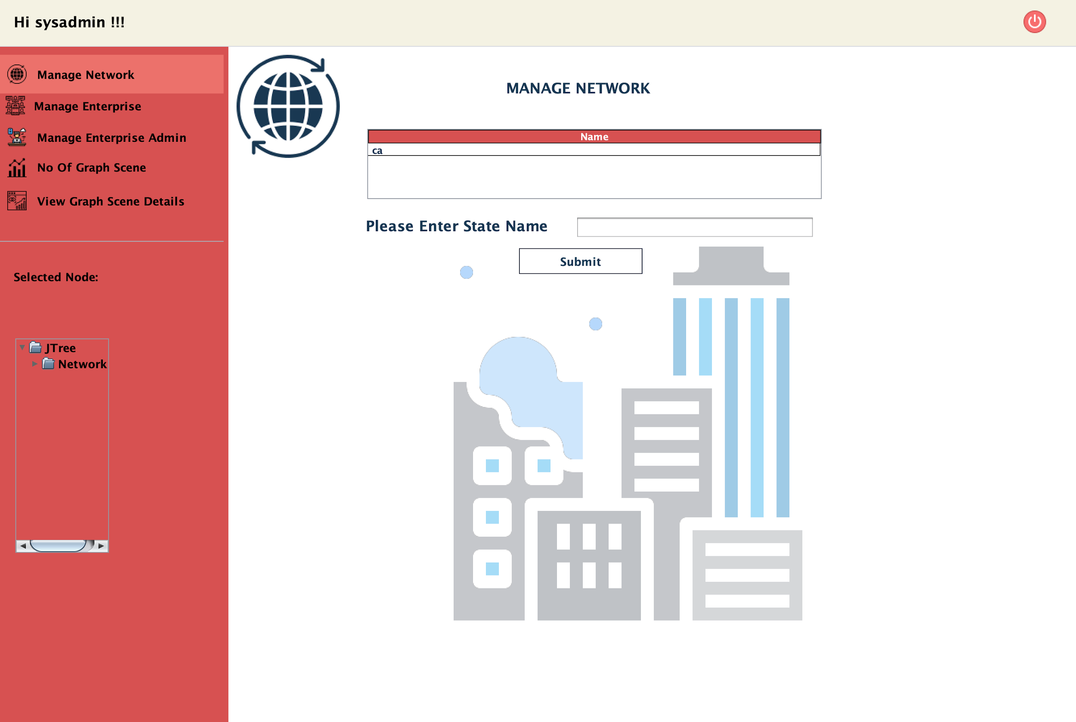
ADMIN PAGE
Place your screenshot here

Slide 23
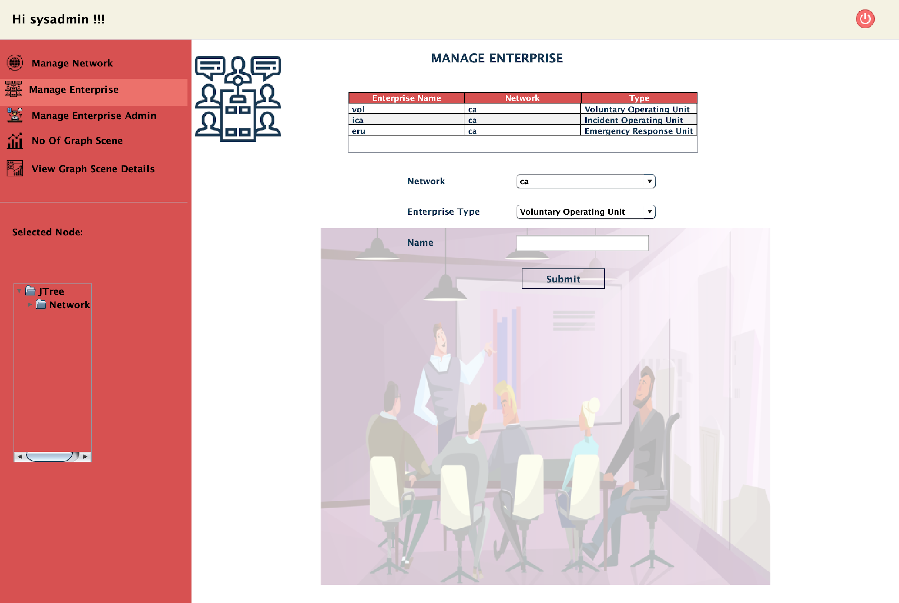
MANAGE ENTERPRISE
Place your screenshot here

Slide 24
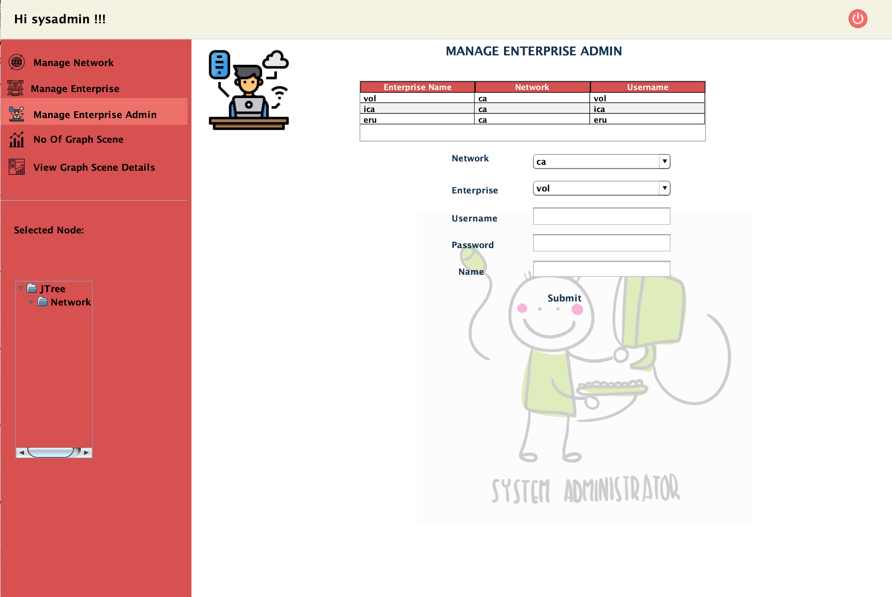
MANAGE ENTERPRISE
ADMIN
Place your screenshot here

Slide 25
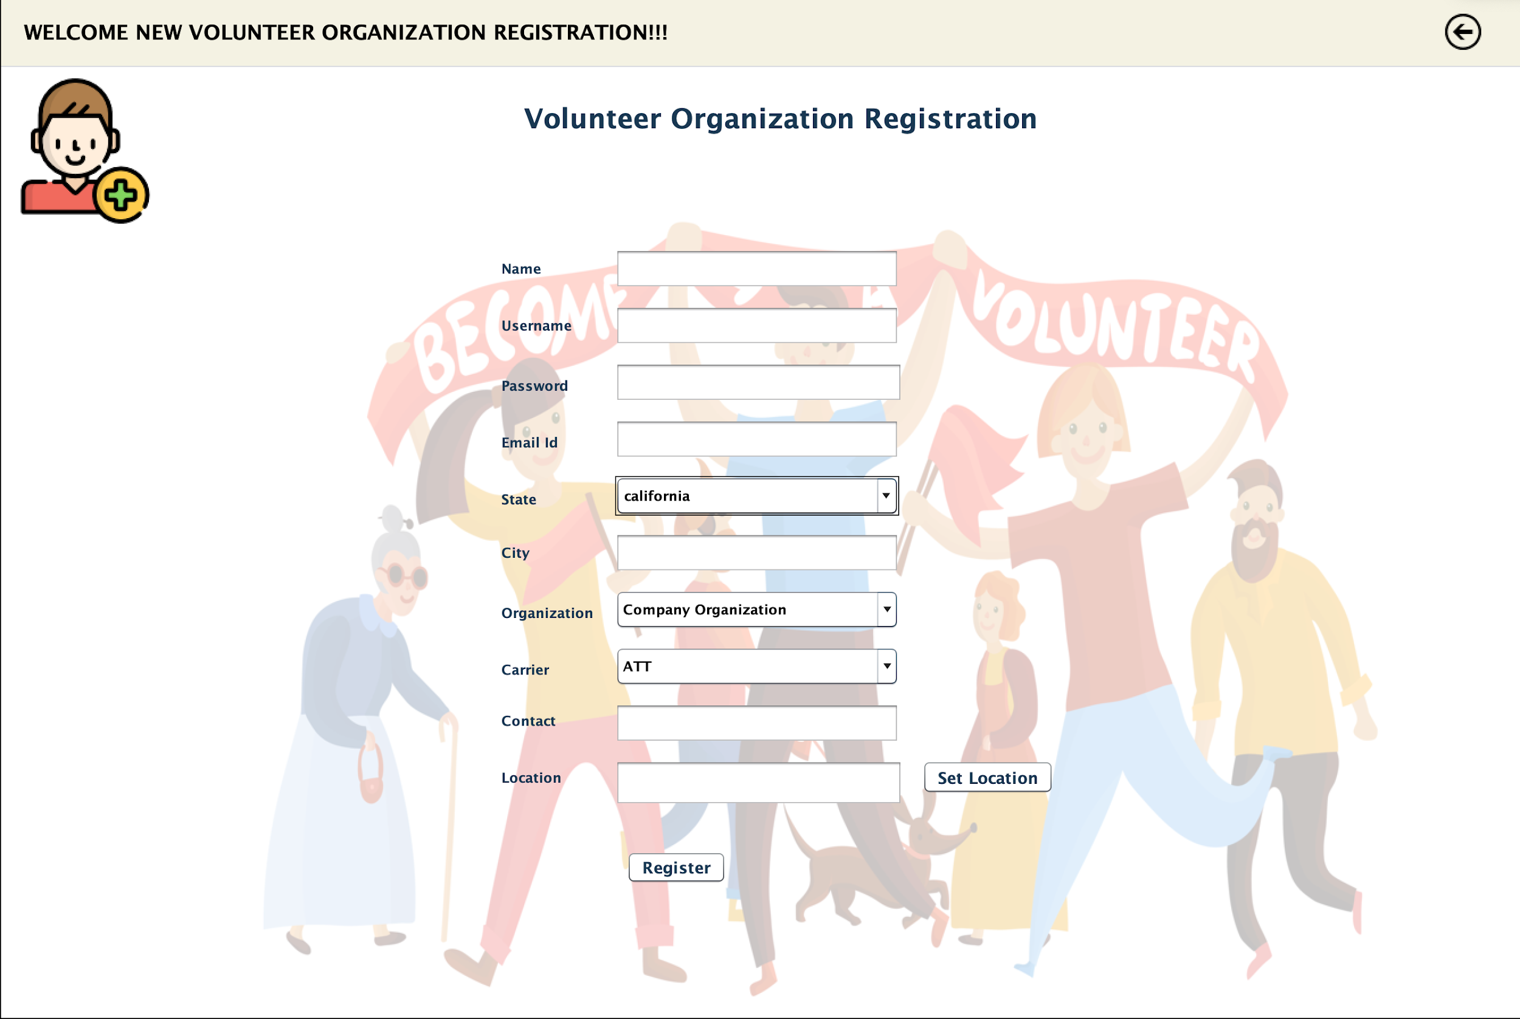
ORGANIZATION
REGISTRATION
Place your screenshot here

Slide 26
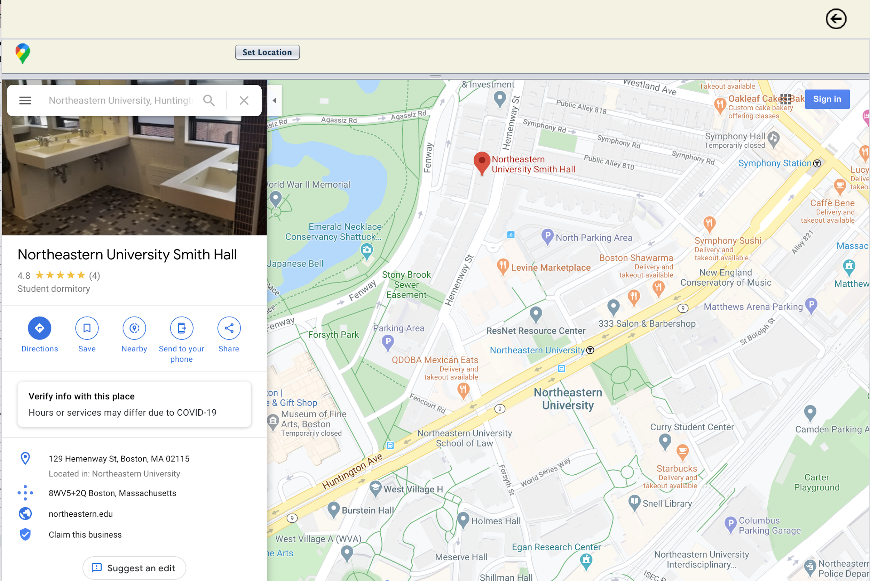
LOCATION SET BY
VOLUNTEER
Place your screenshot here

Slide 27
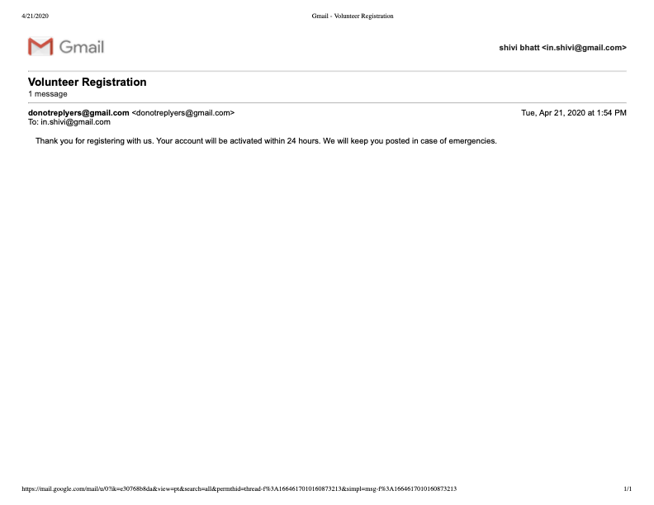
EMAIL SENT TO USER
Place your screenshot here

Slide 28
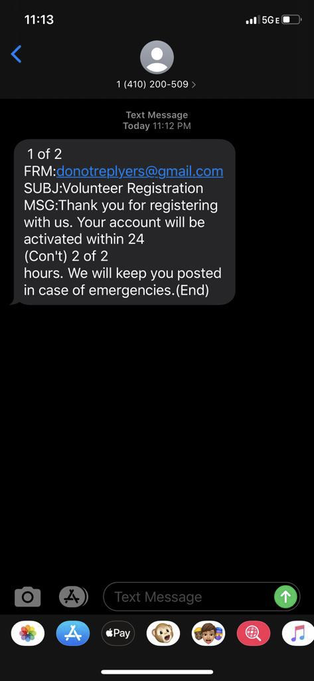
SMS TEXT SENT TO USER

Slide 29
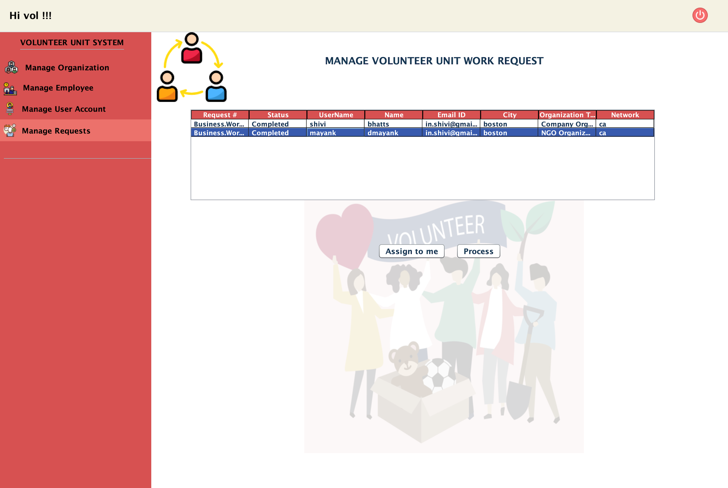
ACTIVATE VOLUNTEER USER USING WORK REQUEST
Place your screenshot here

Slide 30
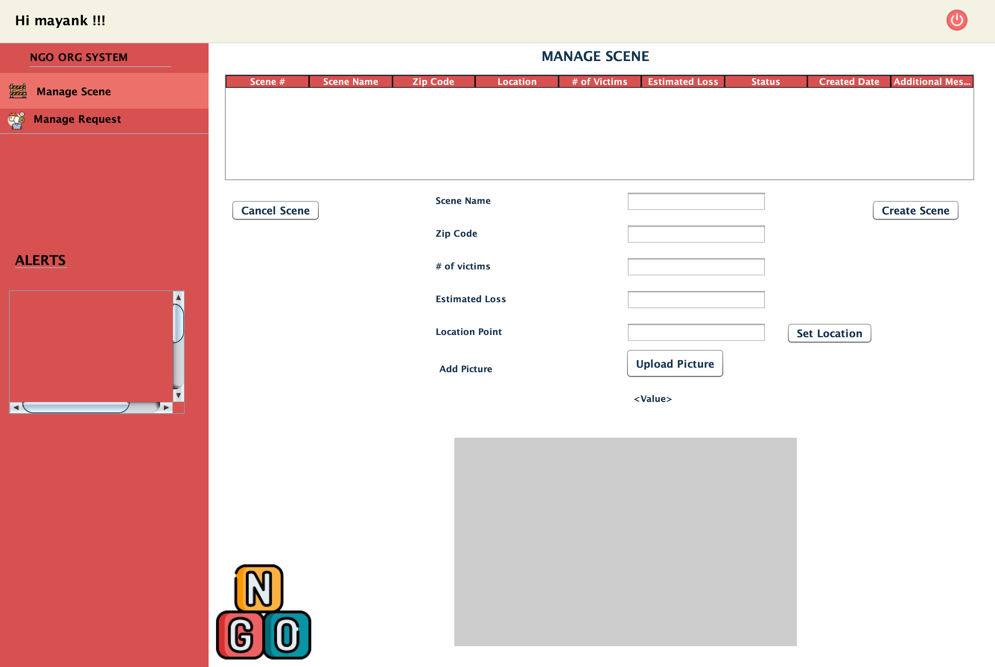
USER ABLE TO LOGIN
Place your screenshot here

Slide 31
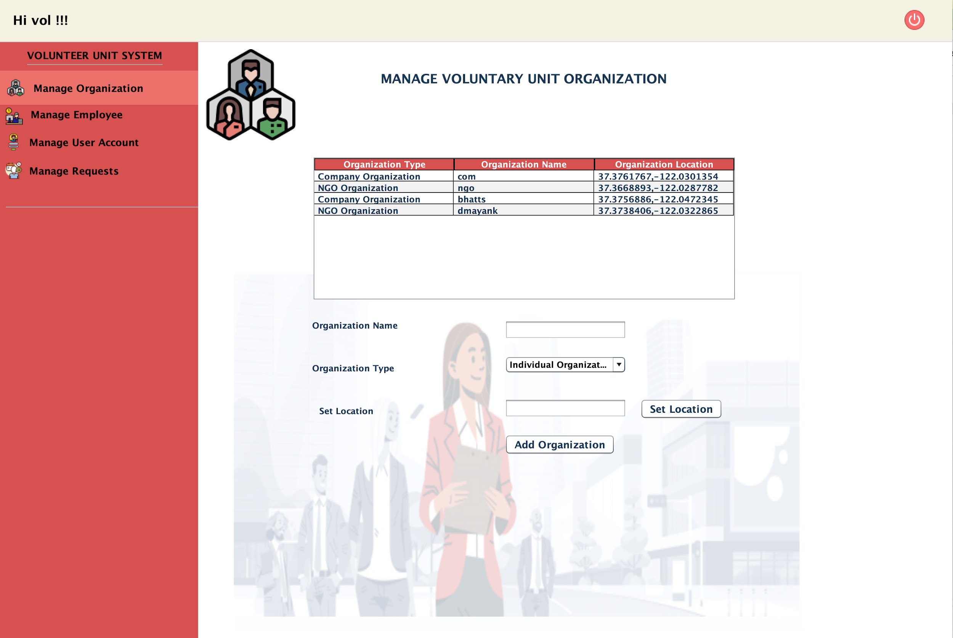
VOLUNTEER ENTERPRISE AND ORGANIZATION
Place your screenshot here

Slide 32
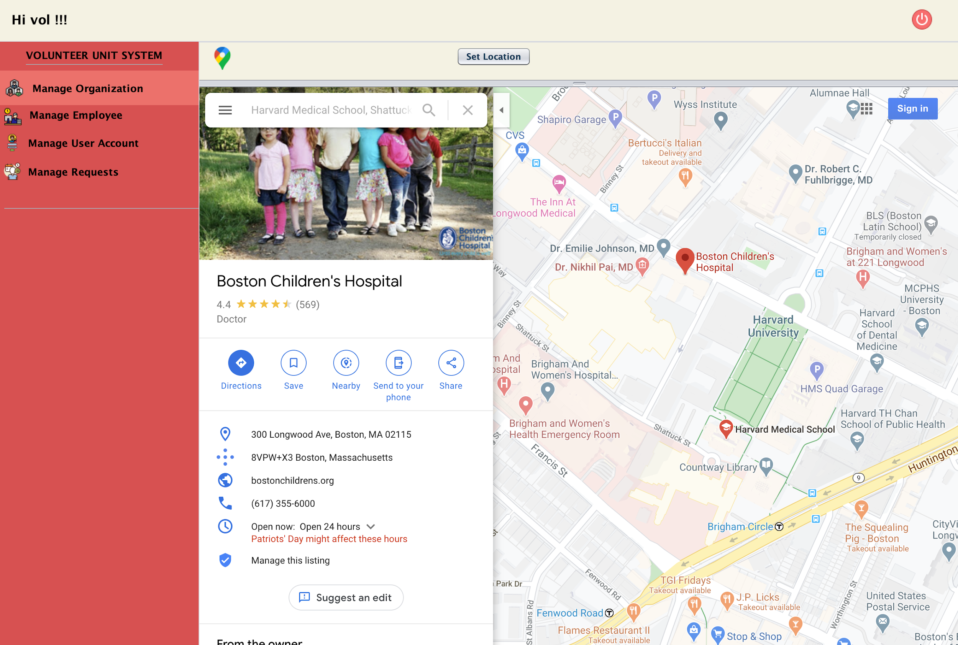
LOCATION CHOSEN FOR ORGANIZATION
Place your screenshot here

Slide 33
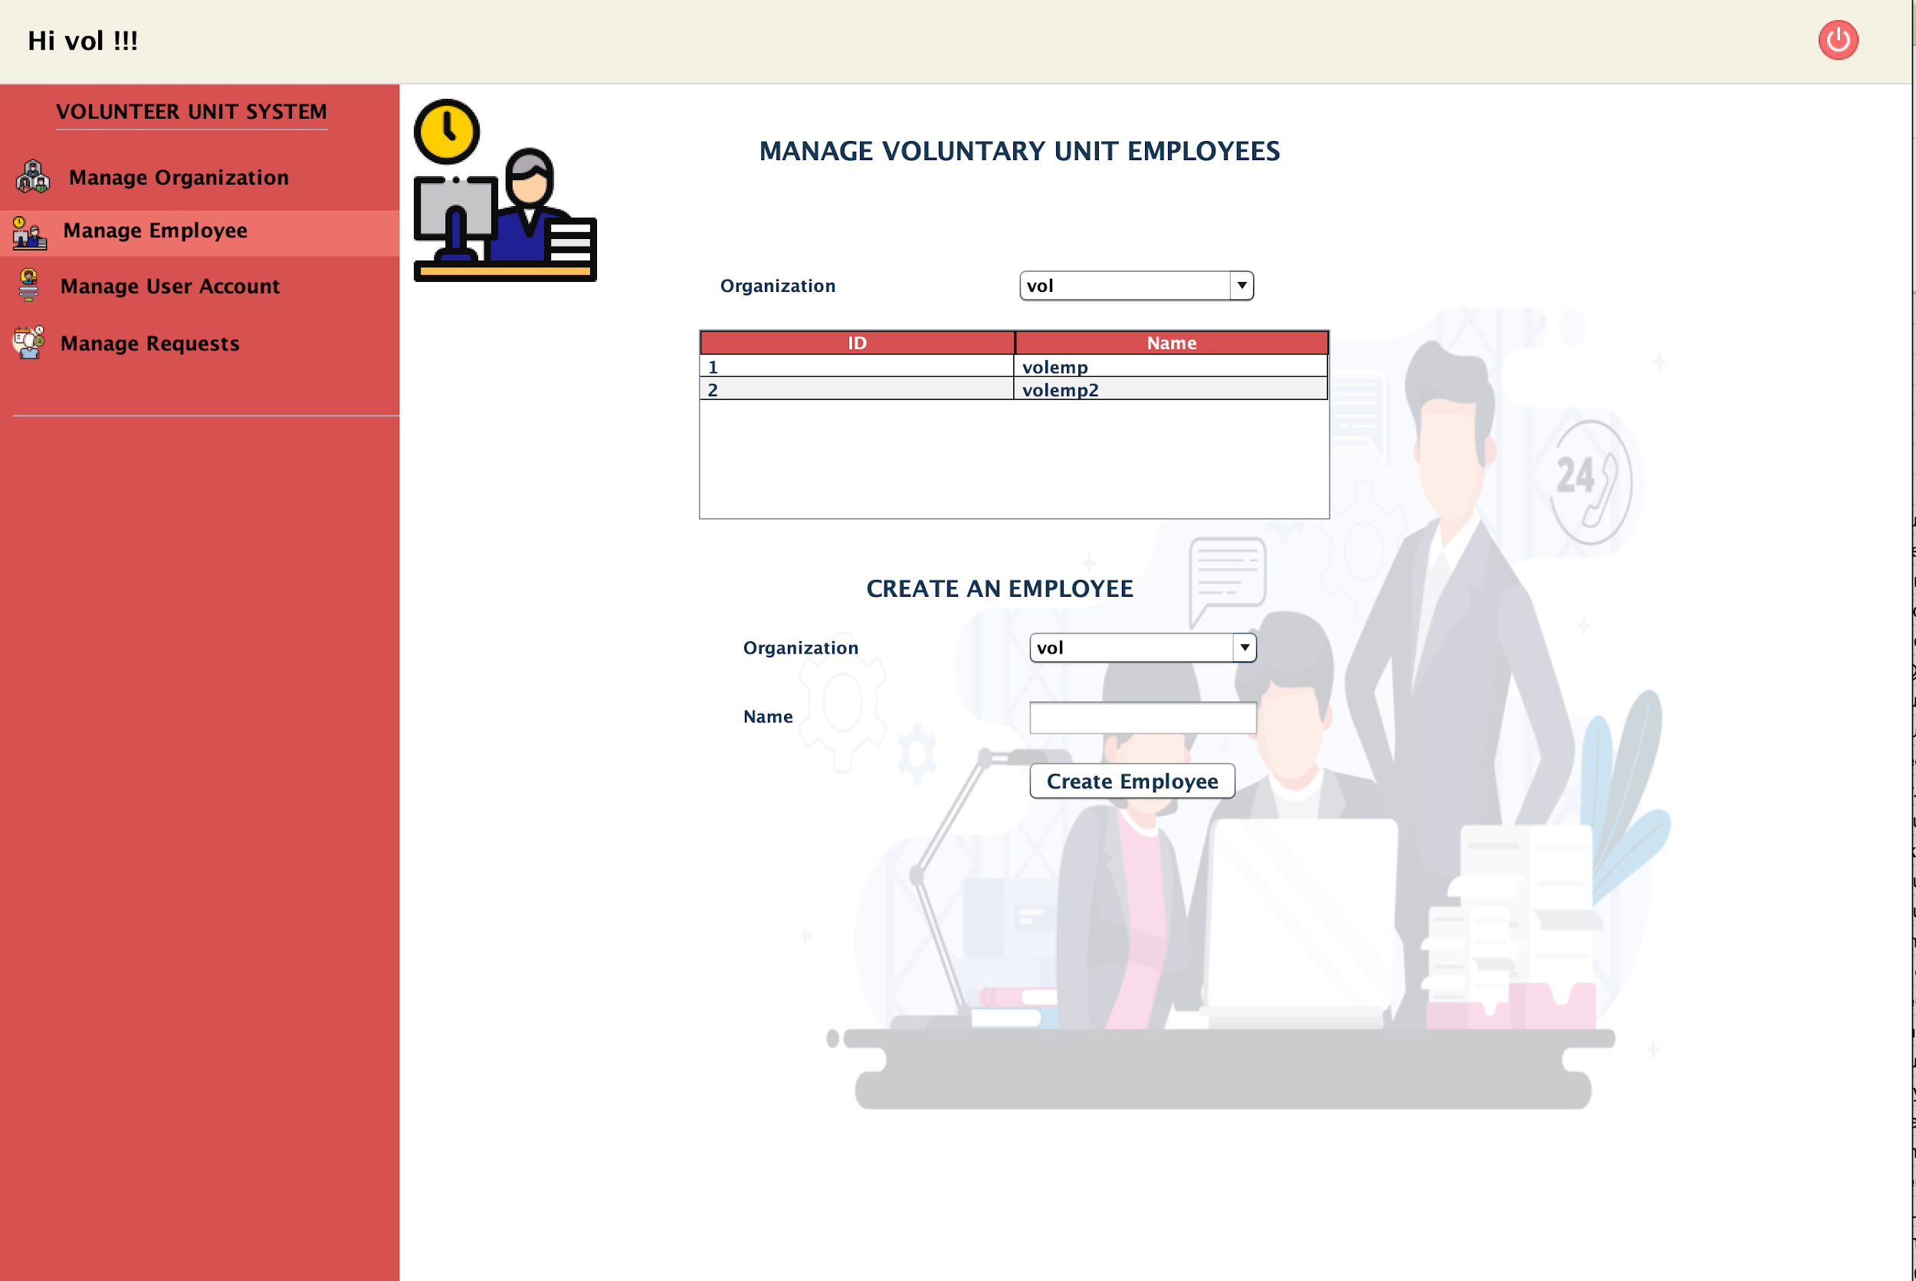
VOLUNTEER EMPLOYEES
Place your screenshot here

Slide 34
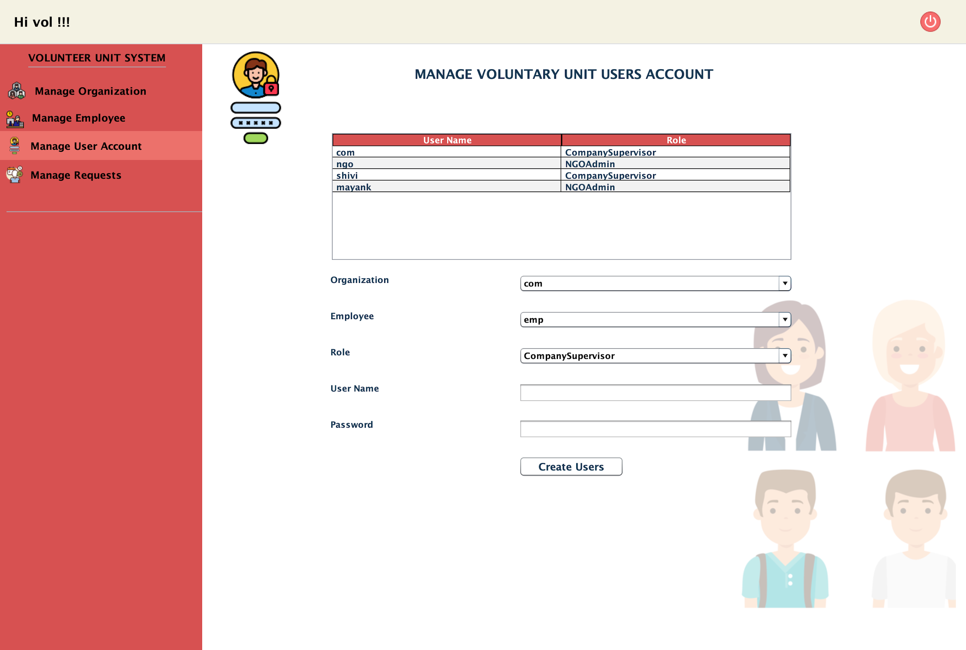
VOLUNTEER USERS
Place your screenshot here

Slide 35
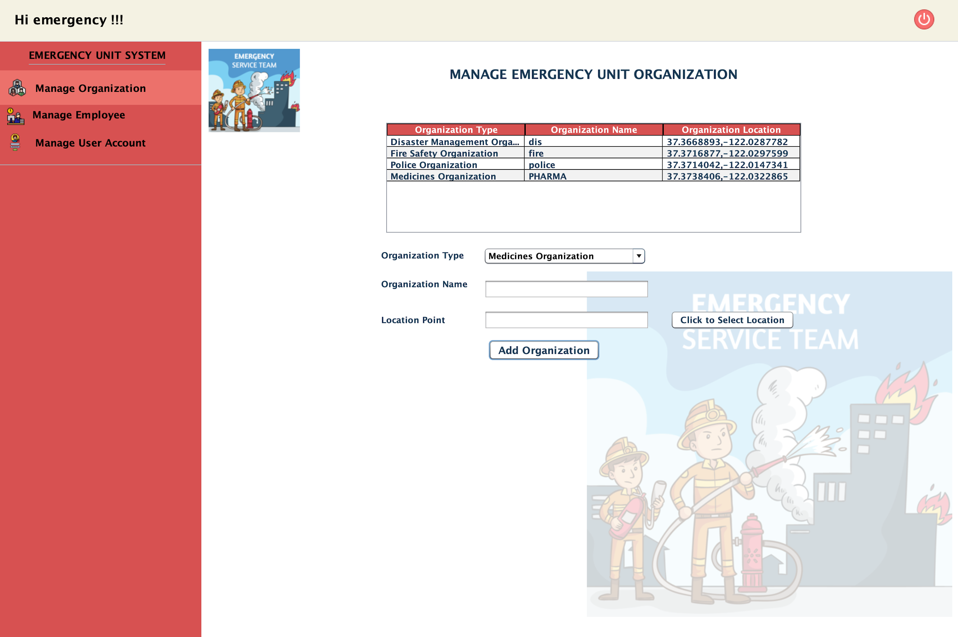
EMERGENCY UNIT ADMIN PAGE
Place your screenshot here

Slide 36
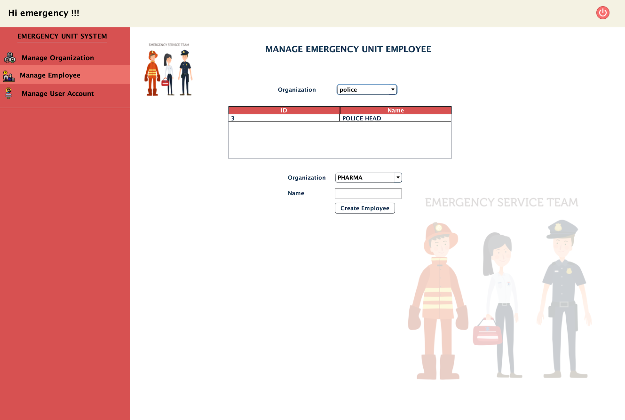
ERU EMPLOYEE MANAGEMENT
Place your screenshot here

Slide 37
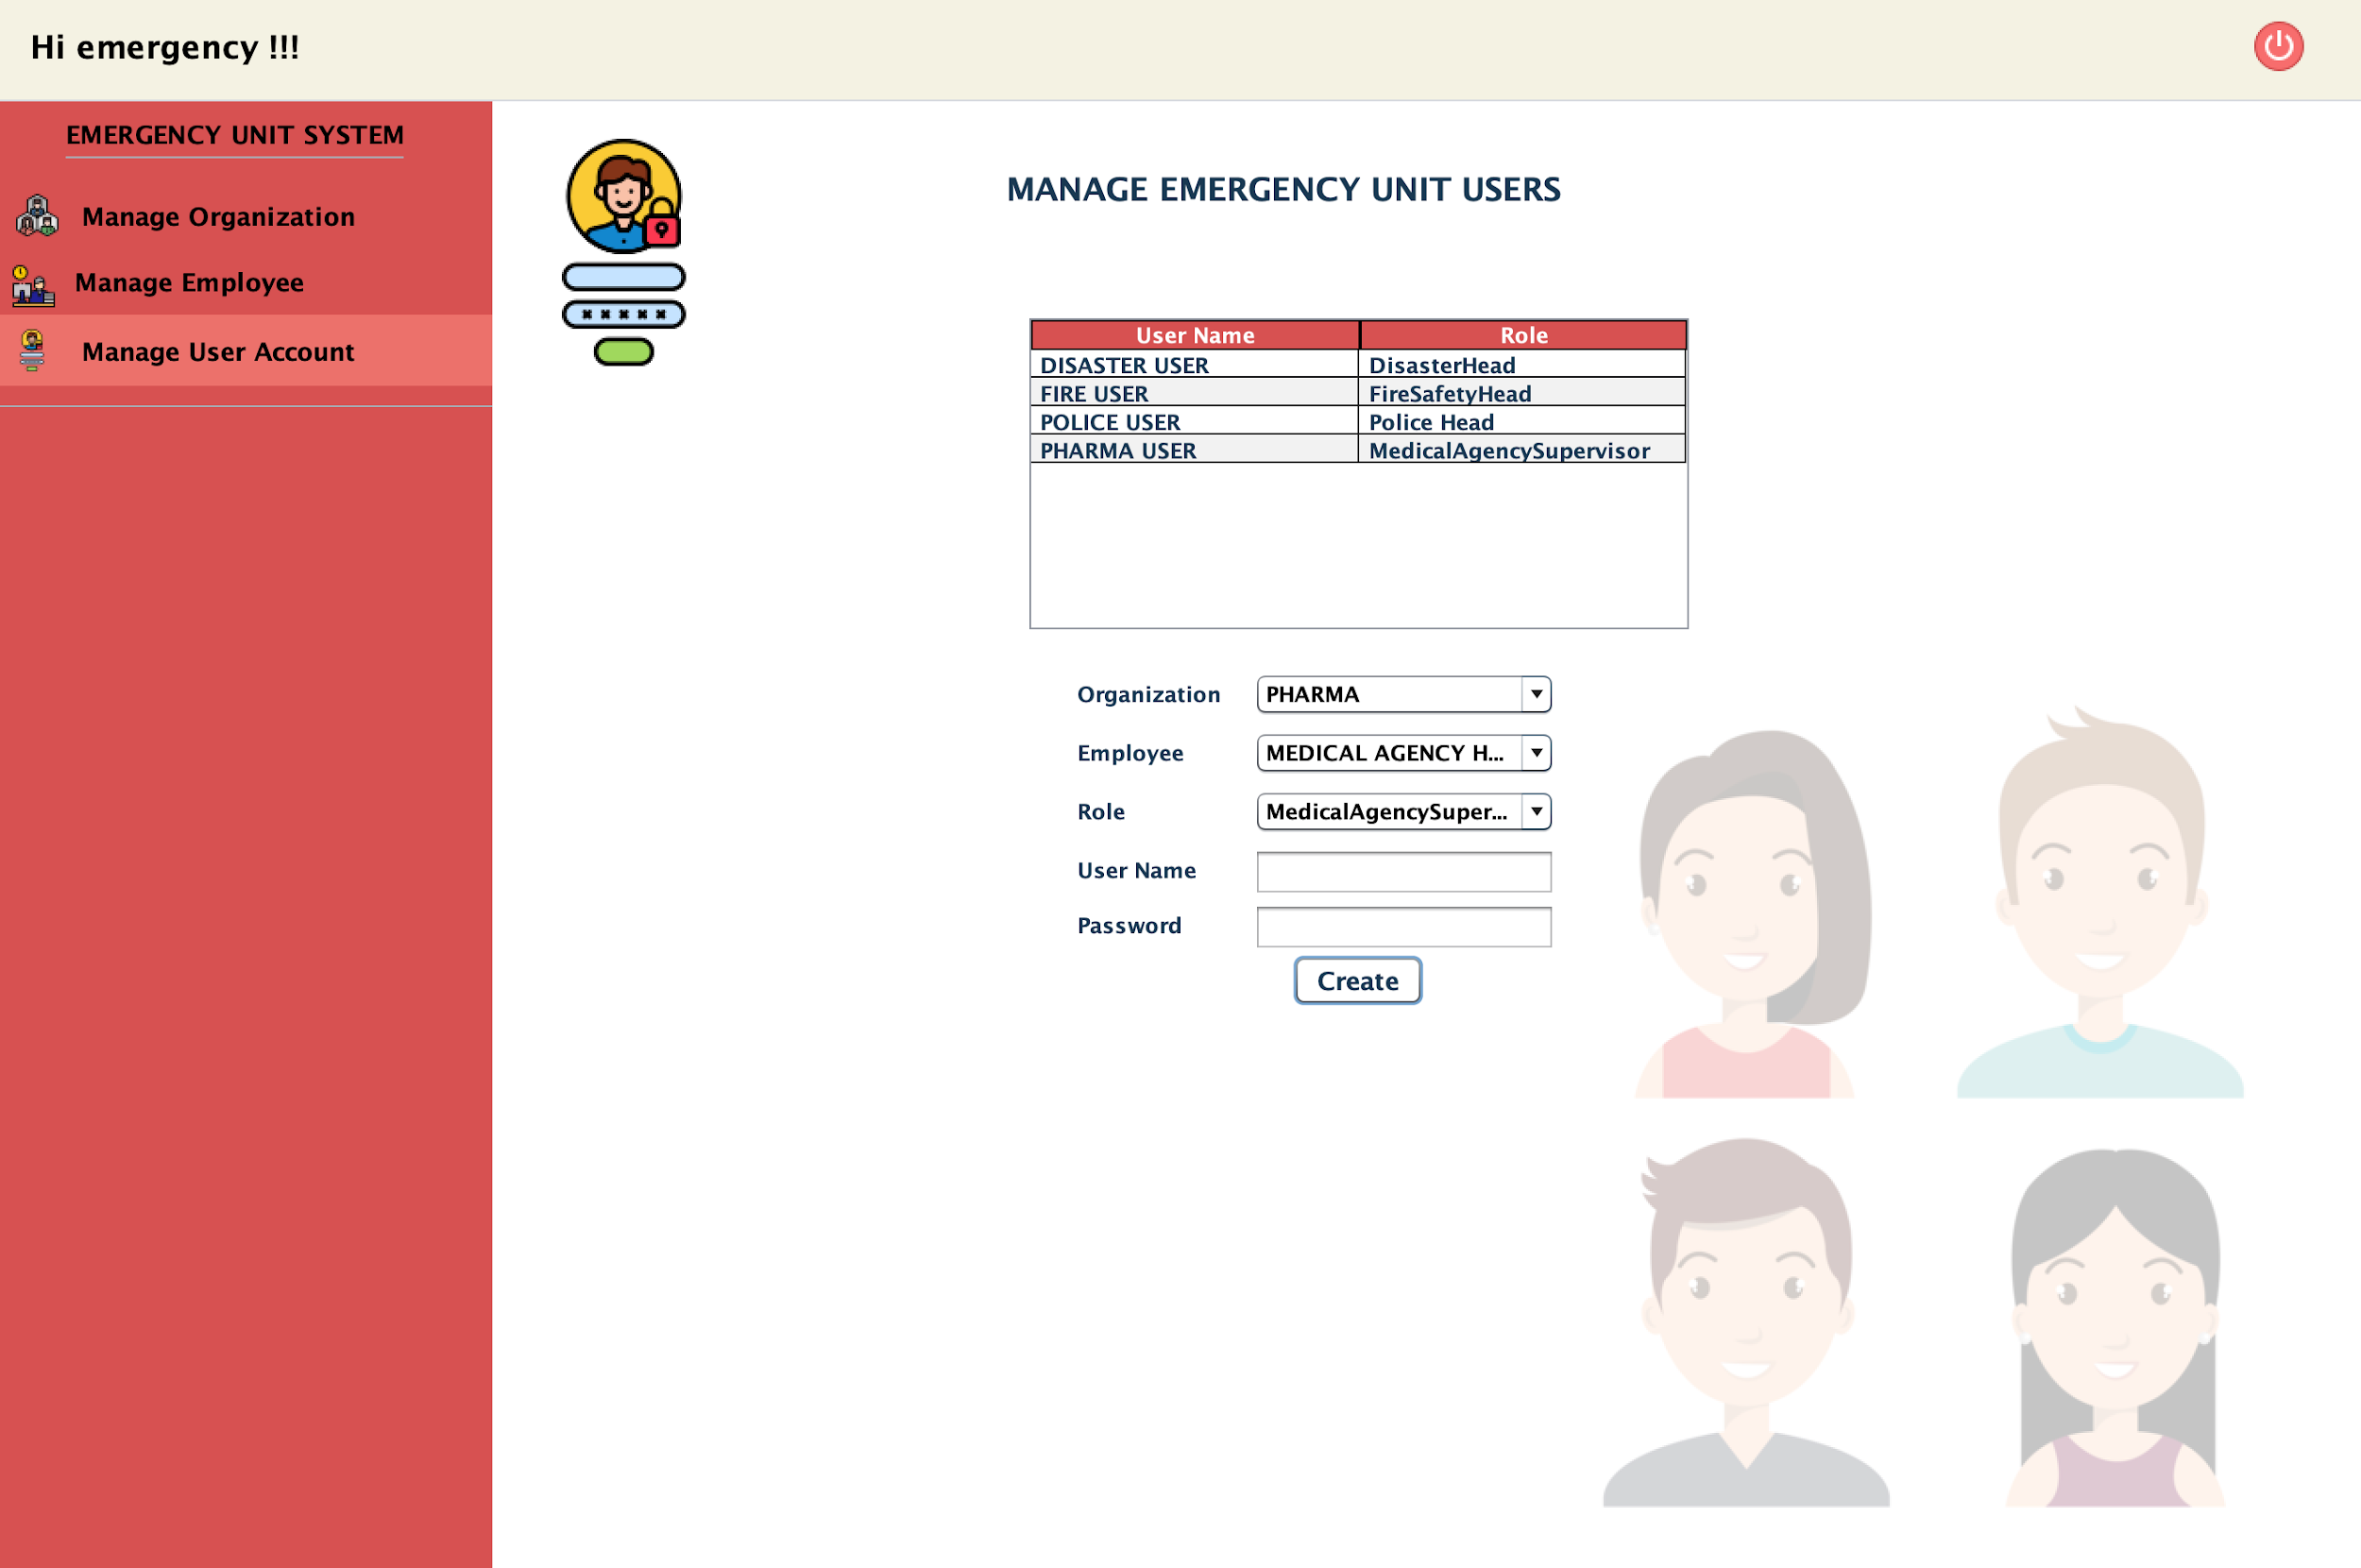
ERU USER ACCOUNT MANAGEMENT
Place your screenshot here

Slide 38
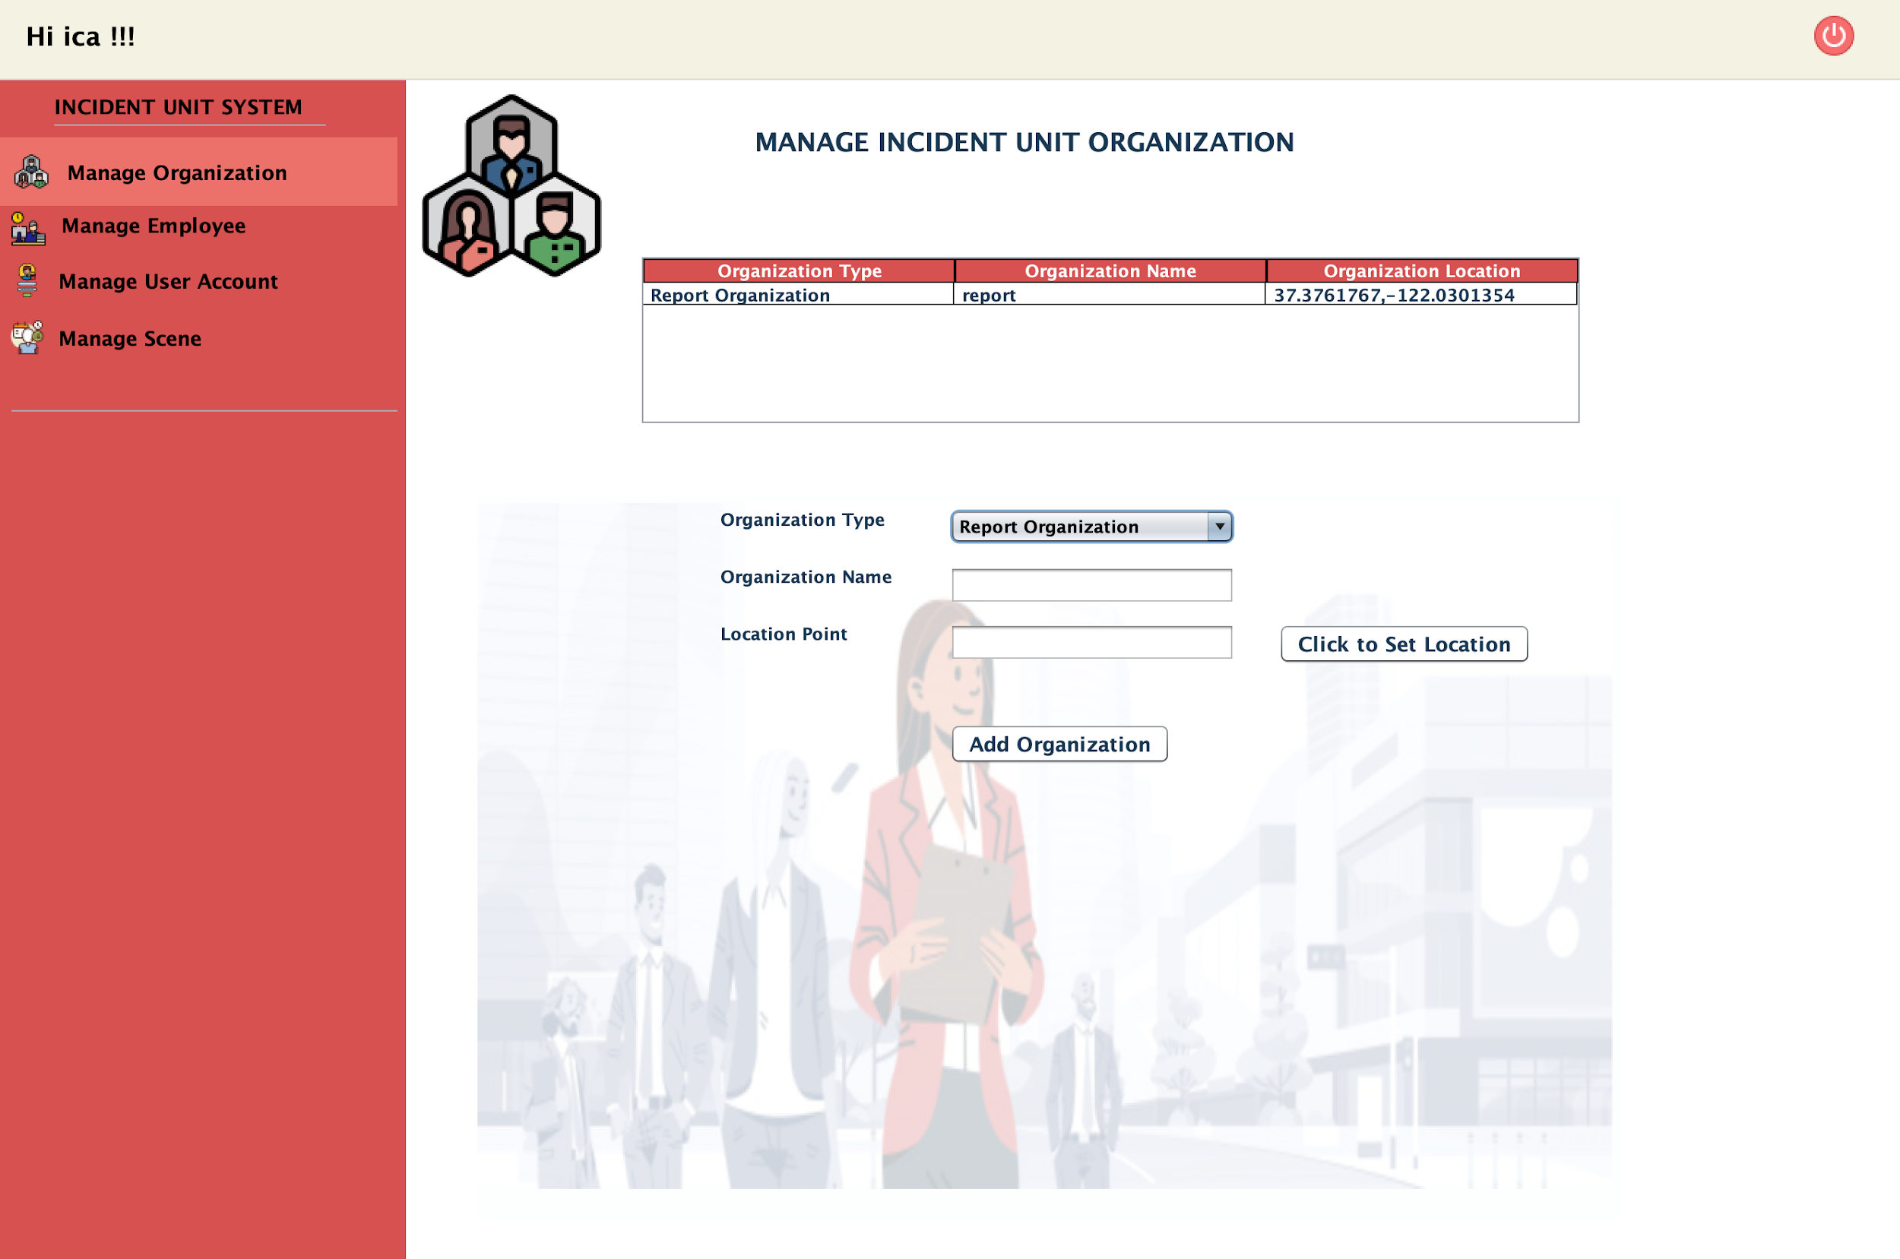
INCIDENT UNIT SYSTEM AND ORG PAGE
Place your screenshot here

Slide 39
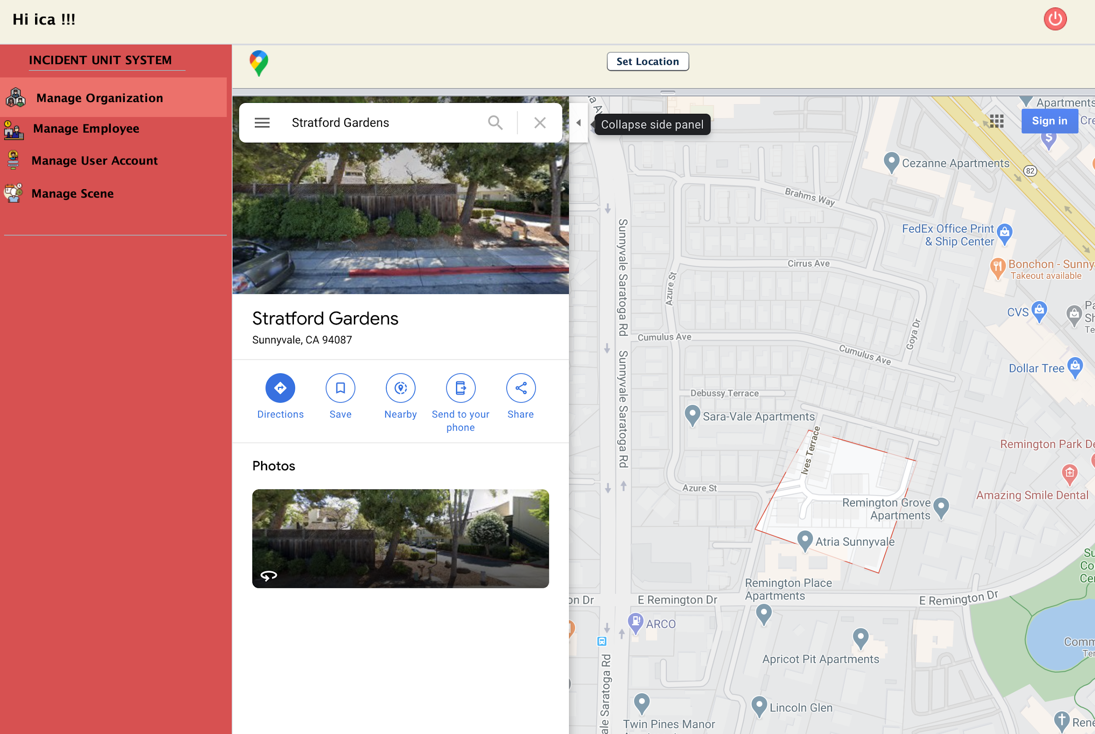
INCIDENT UNIT SYSTEM AND ORGANIZATION MANAGEMENT USER ABLE TO SET LOCATION FOR ORGANIZATION
Place your screenshot here

Slide 40
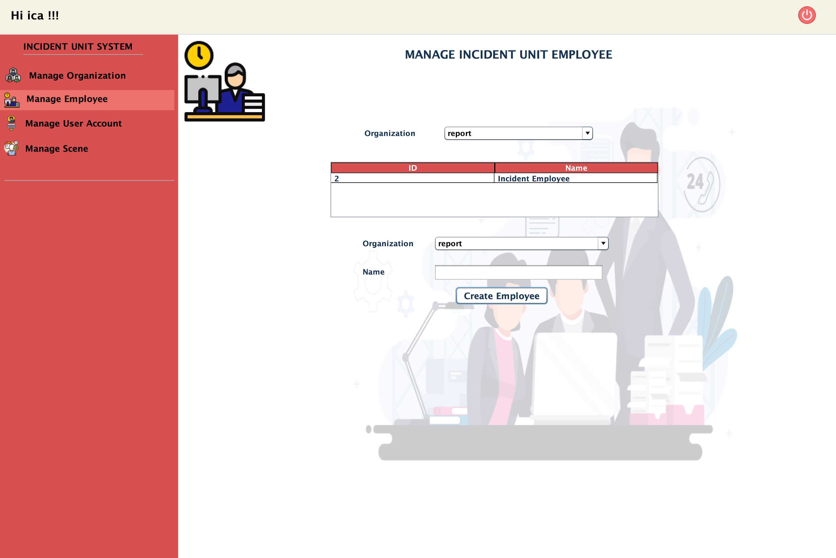
INCIDENT UNIT SYSTEM EMPLOYEE MANAGEMENT
Place your screenshot here

Slide 41
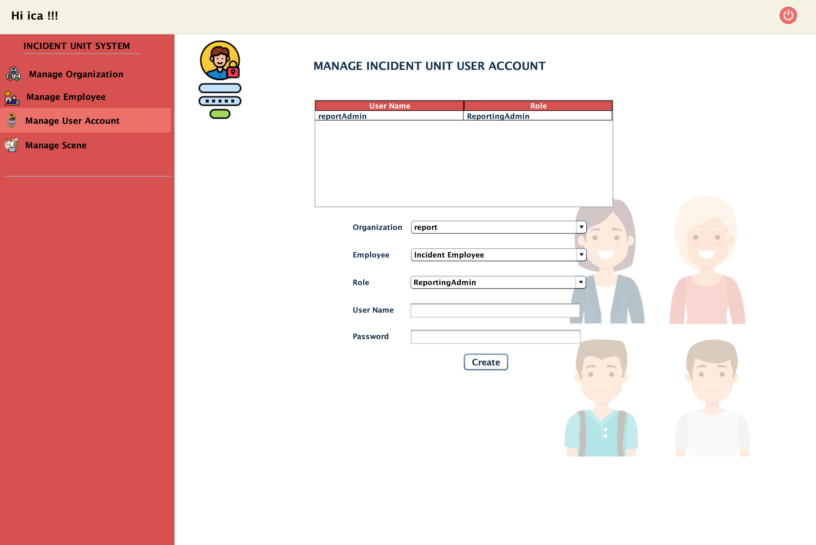
INCIDENT UNIT SYSTEM USER ACCOUNT
MANAGEMENT
Place your screenshot here

Slide 42
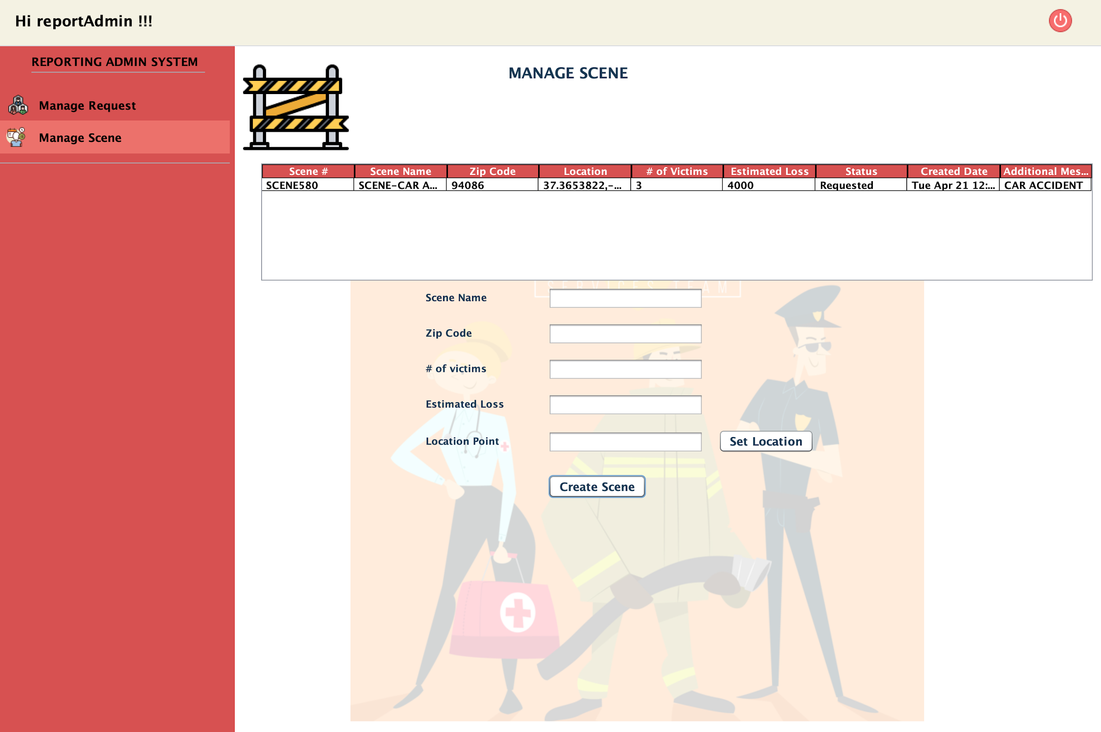
REPORT ADMIN- CREATE SCENE CAPABILITIES
Place your screenshot here

Slide 43
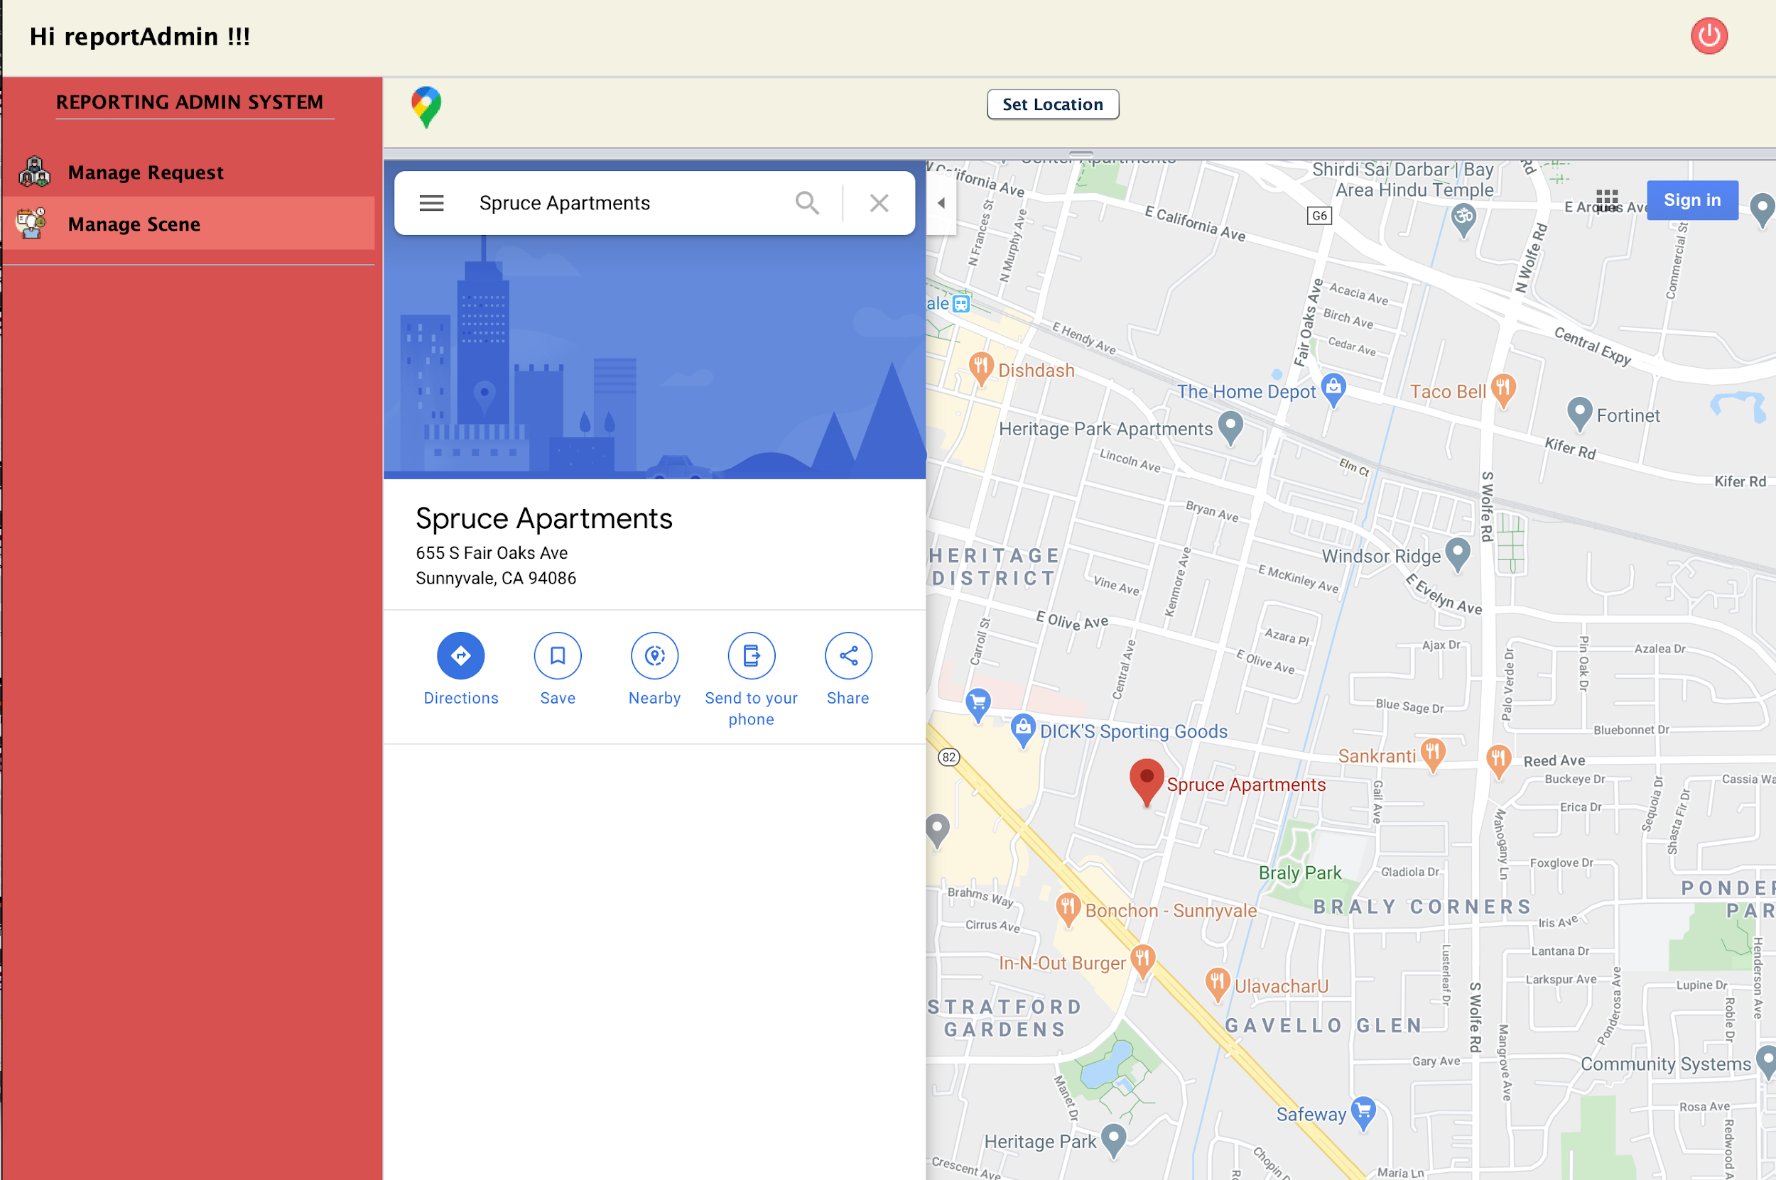
REPORT ADMIN- ABLE TO SET LOCATION OF THE SCENE
Place your screenshot here

Slide 44
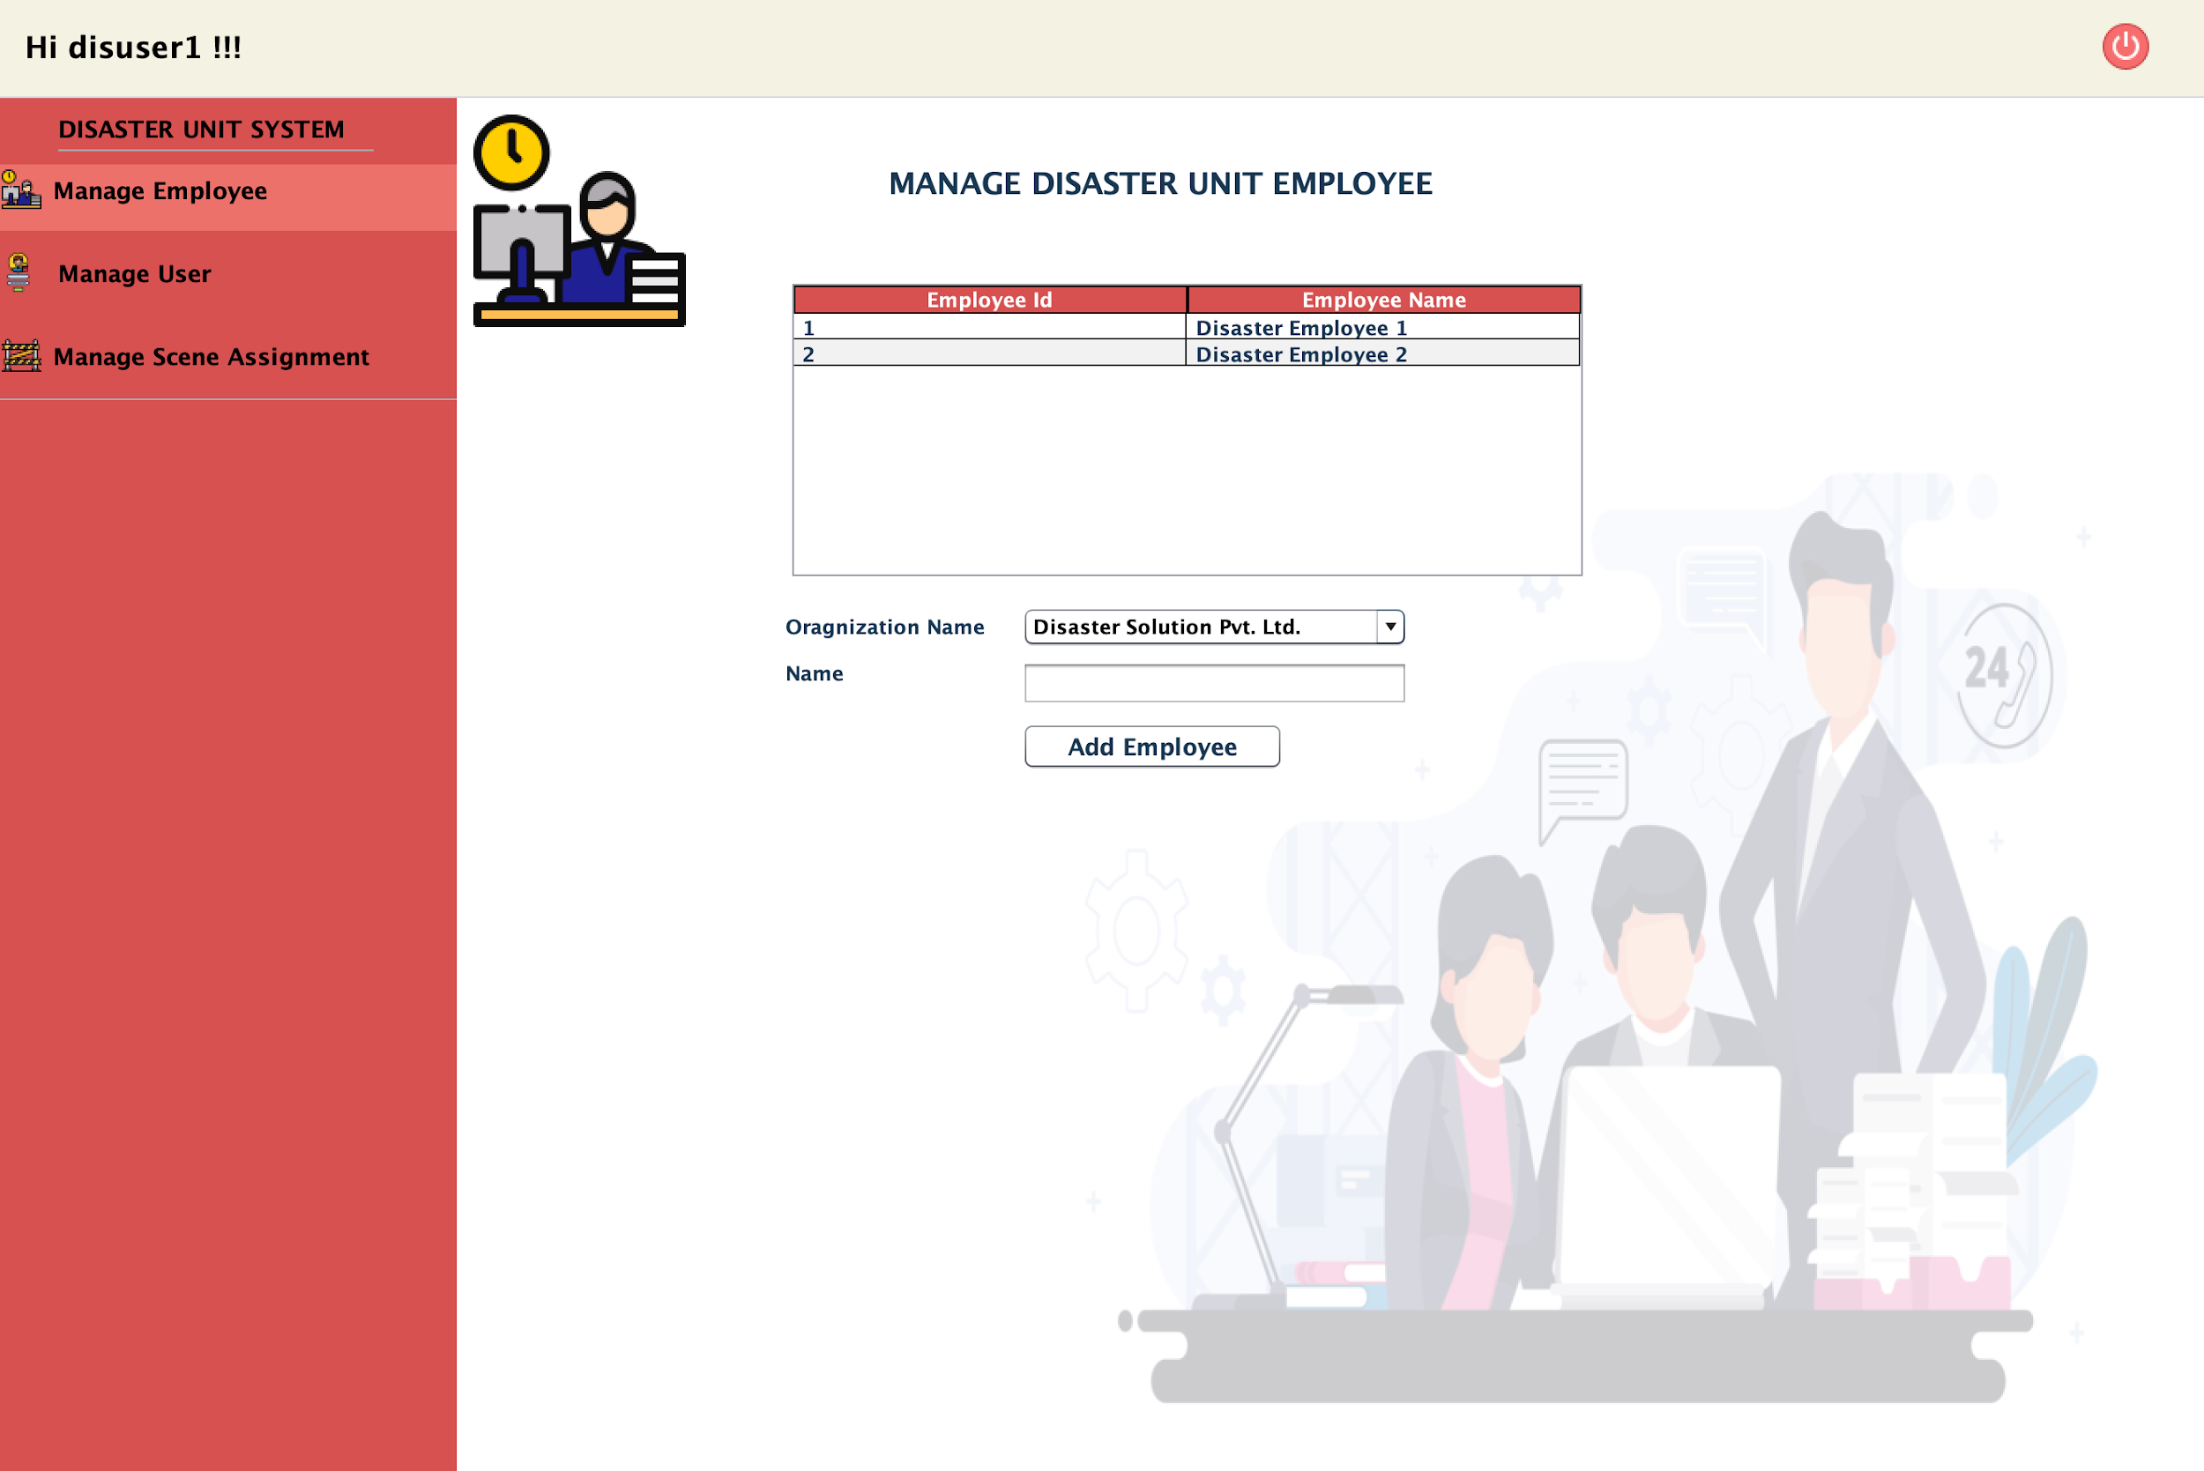
DISASTER HEAD LOGIN AND MANAGE EMPLOYEE
Place your screenshot here

Slide 45
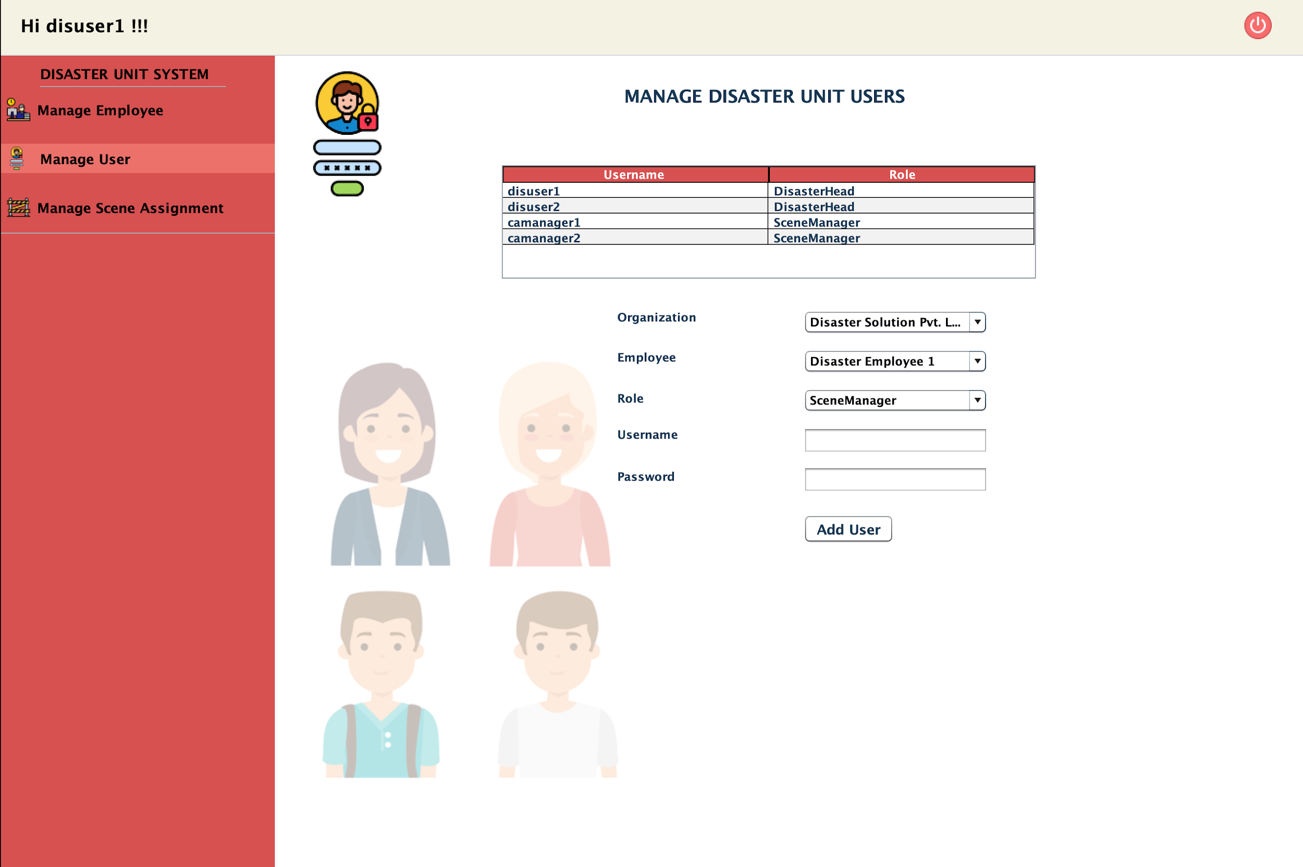
DISASTER HEAD LOGIN AND MANAGE SCENE MANAGER USERS
Place your screenshot here

Slide 46
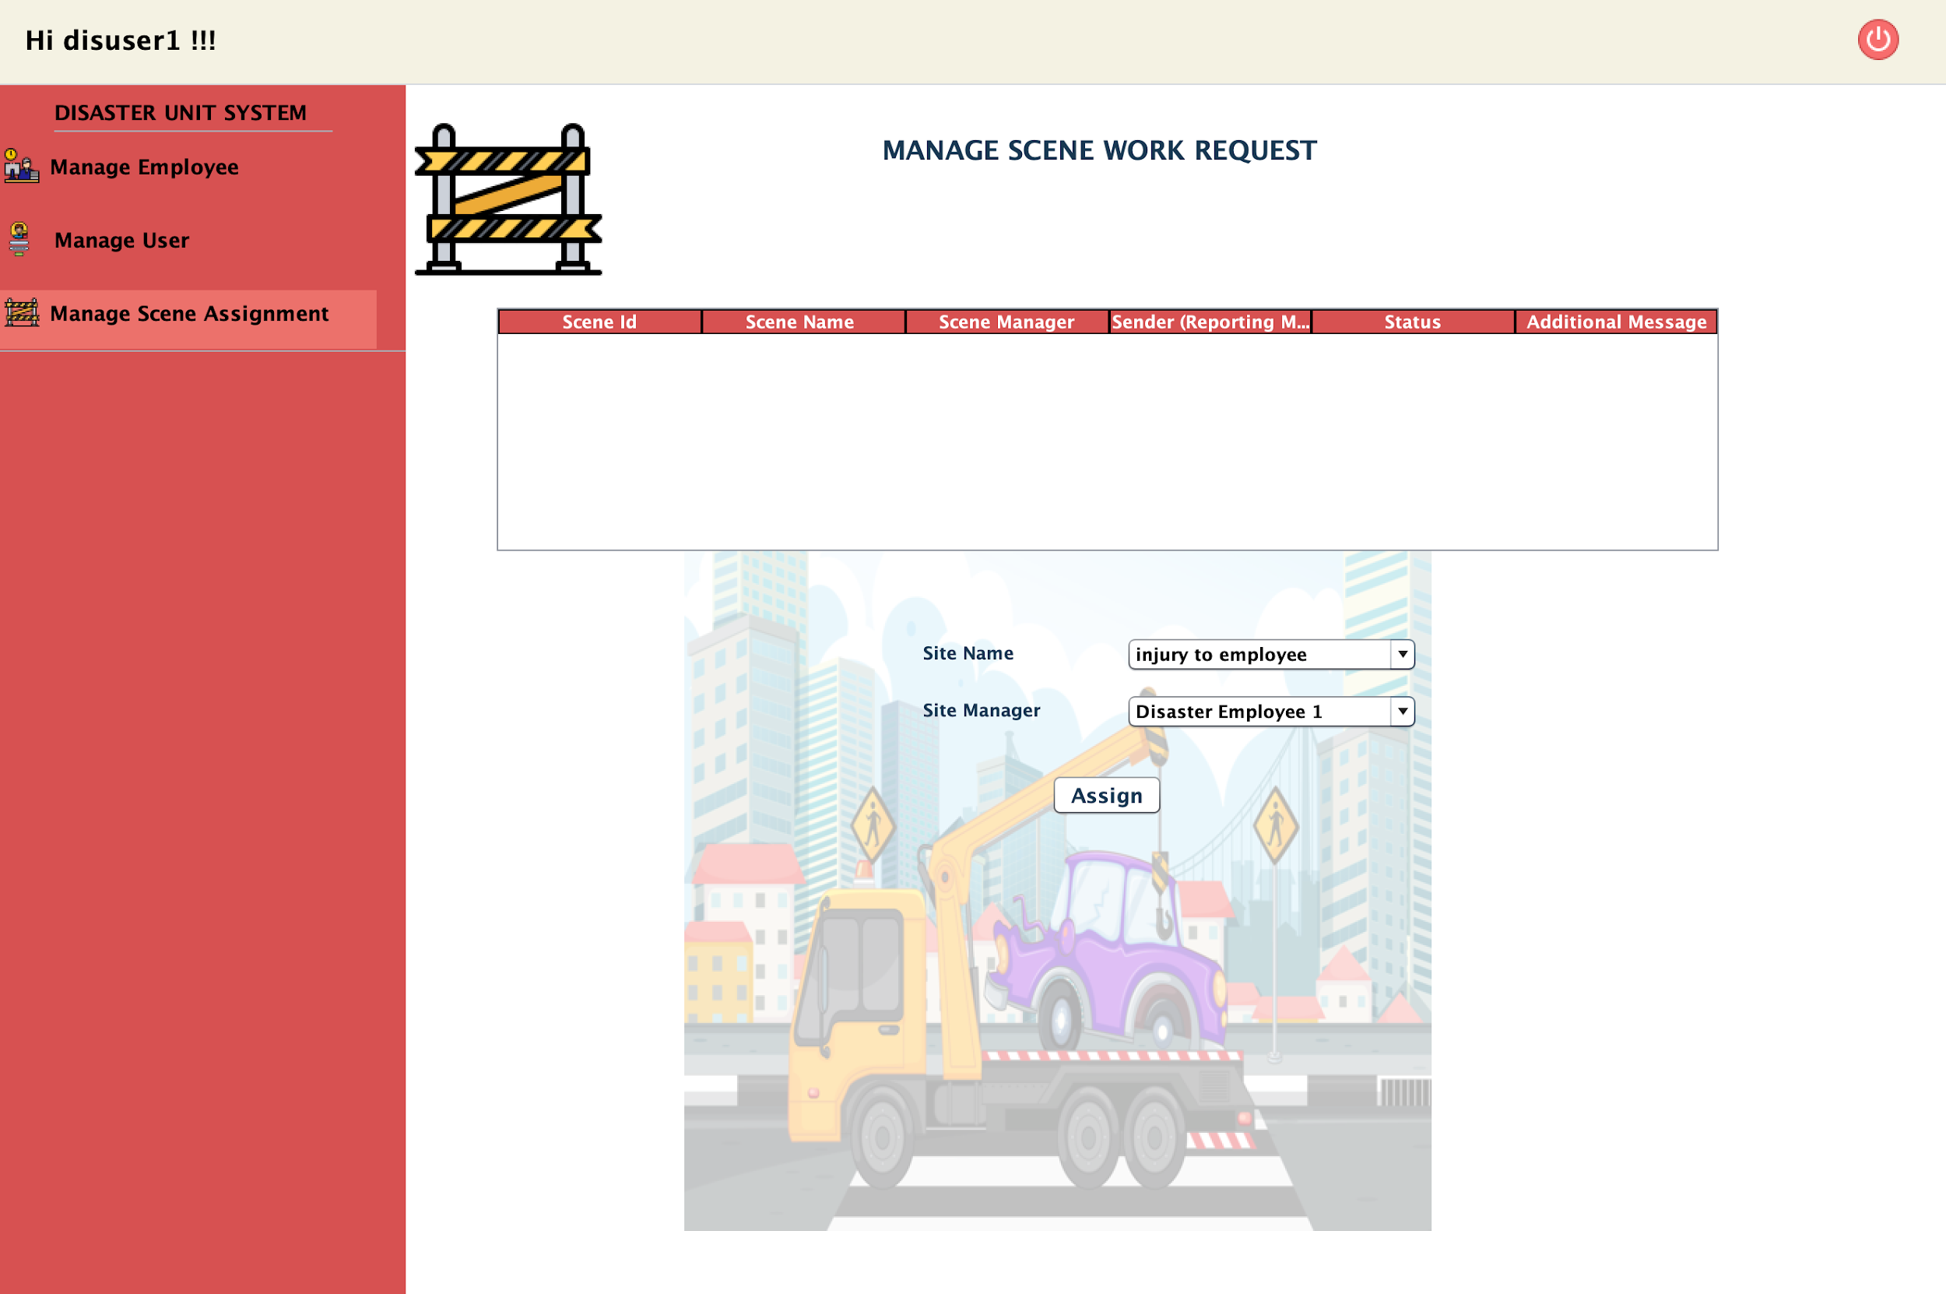
DISASTER HEAD CAPABILITIES :
ASSIGN SITE MANAGER TO SITE NAME
Place your screenshot here

Slide 47
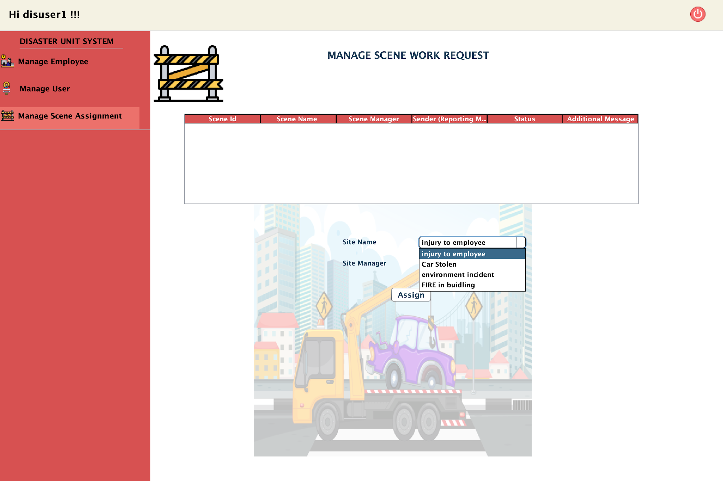
DISASTER HEAD CAPABILITIES -
ABLE TO SEE ALL SCENE HAPPENED IN THE NETWORK
Place your screenshot here

Slide 48
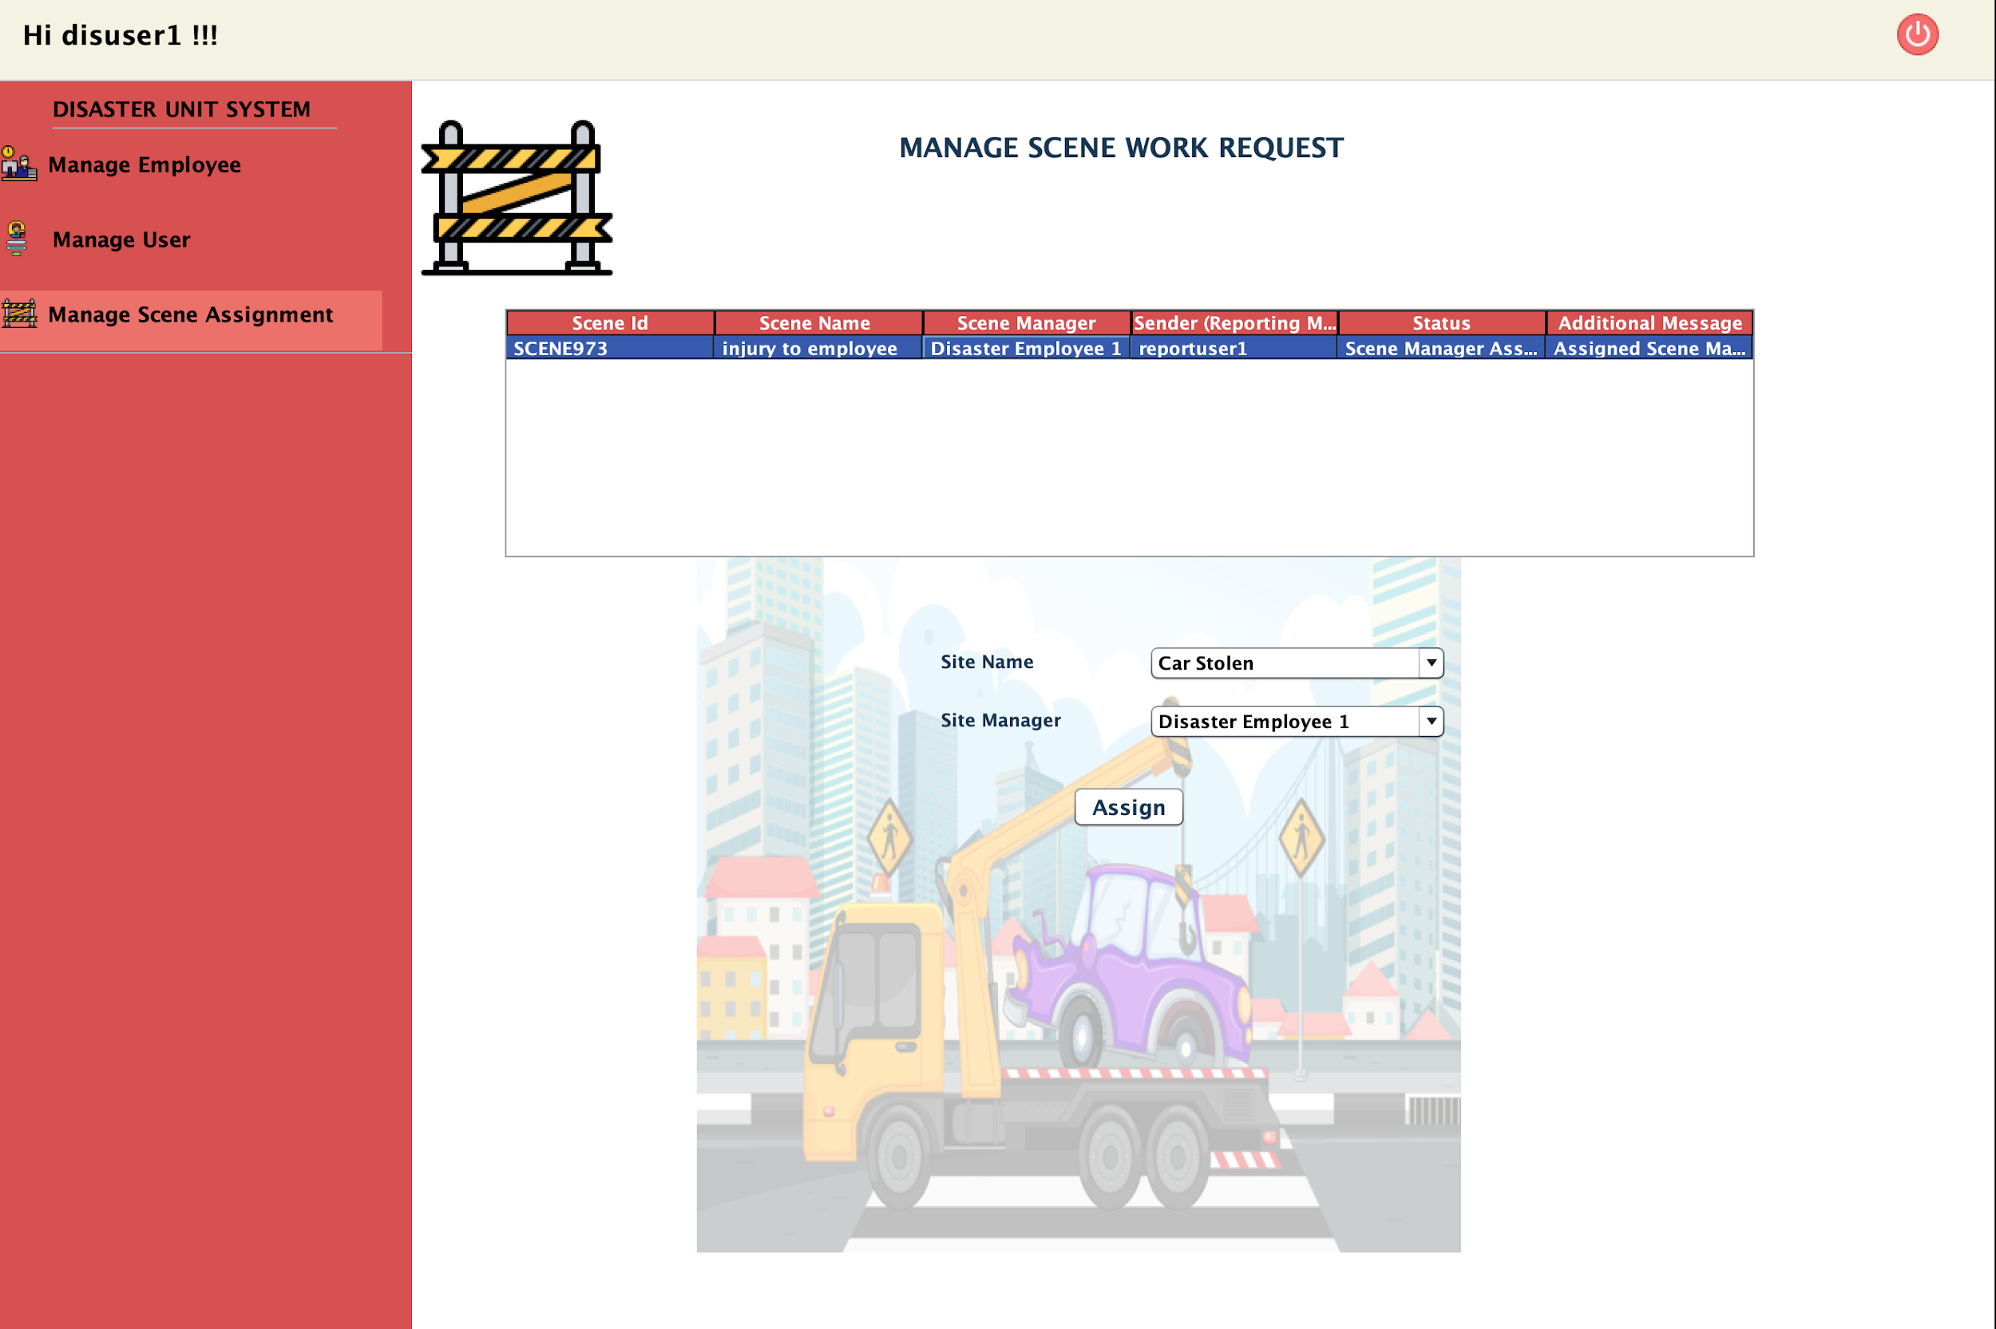
DISASTER HEAD CAPABILITIES -
WORK REQUEST CREATED STATUS - Scene Manager Assigned
Place your screenshot here

Slide 49
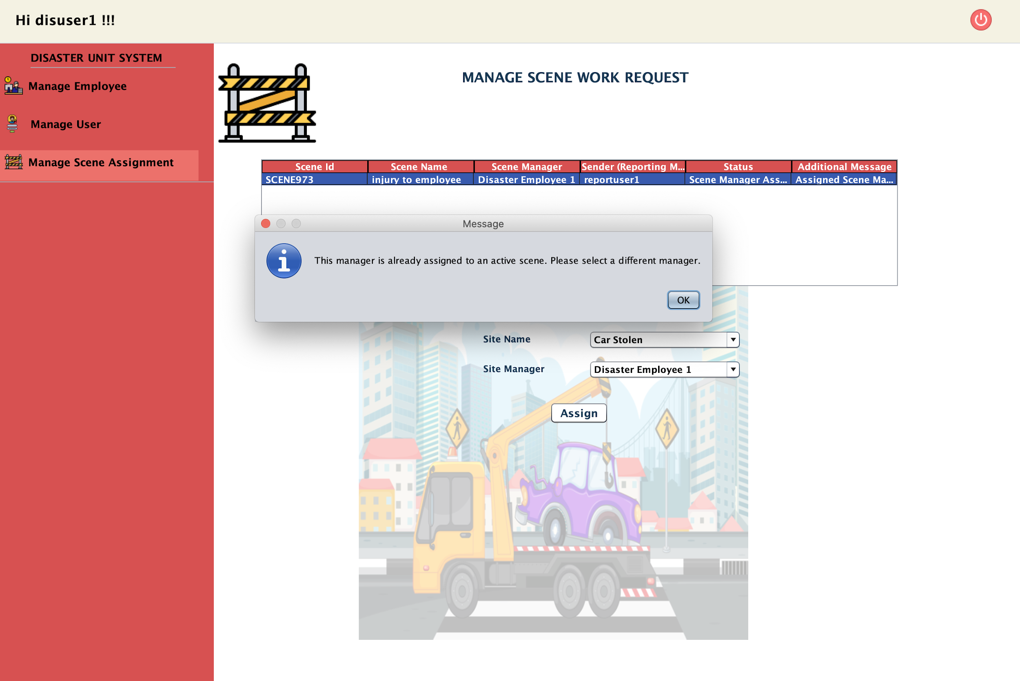
DISASTER HEAD CAPABILITIES -
Scene manager works on single scene.
Place your screenshot here

Slide 50
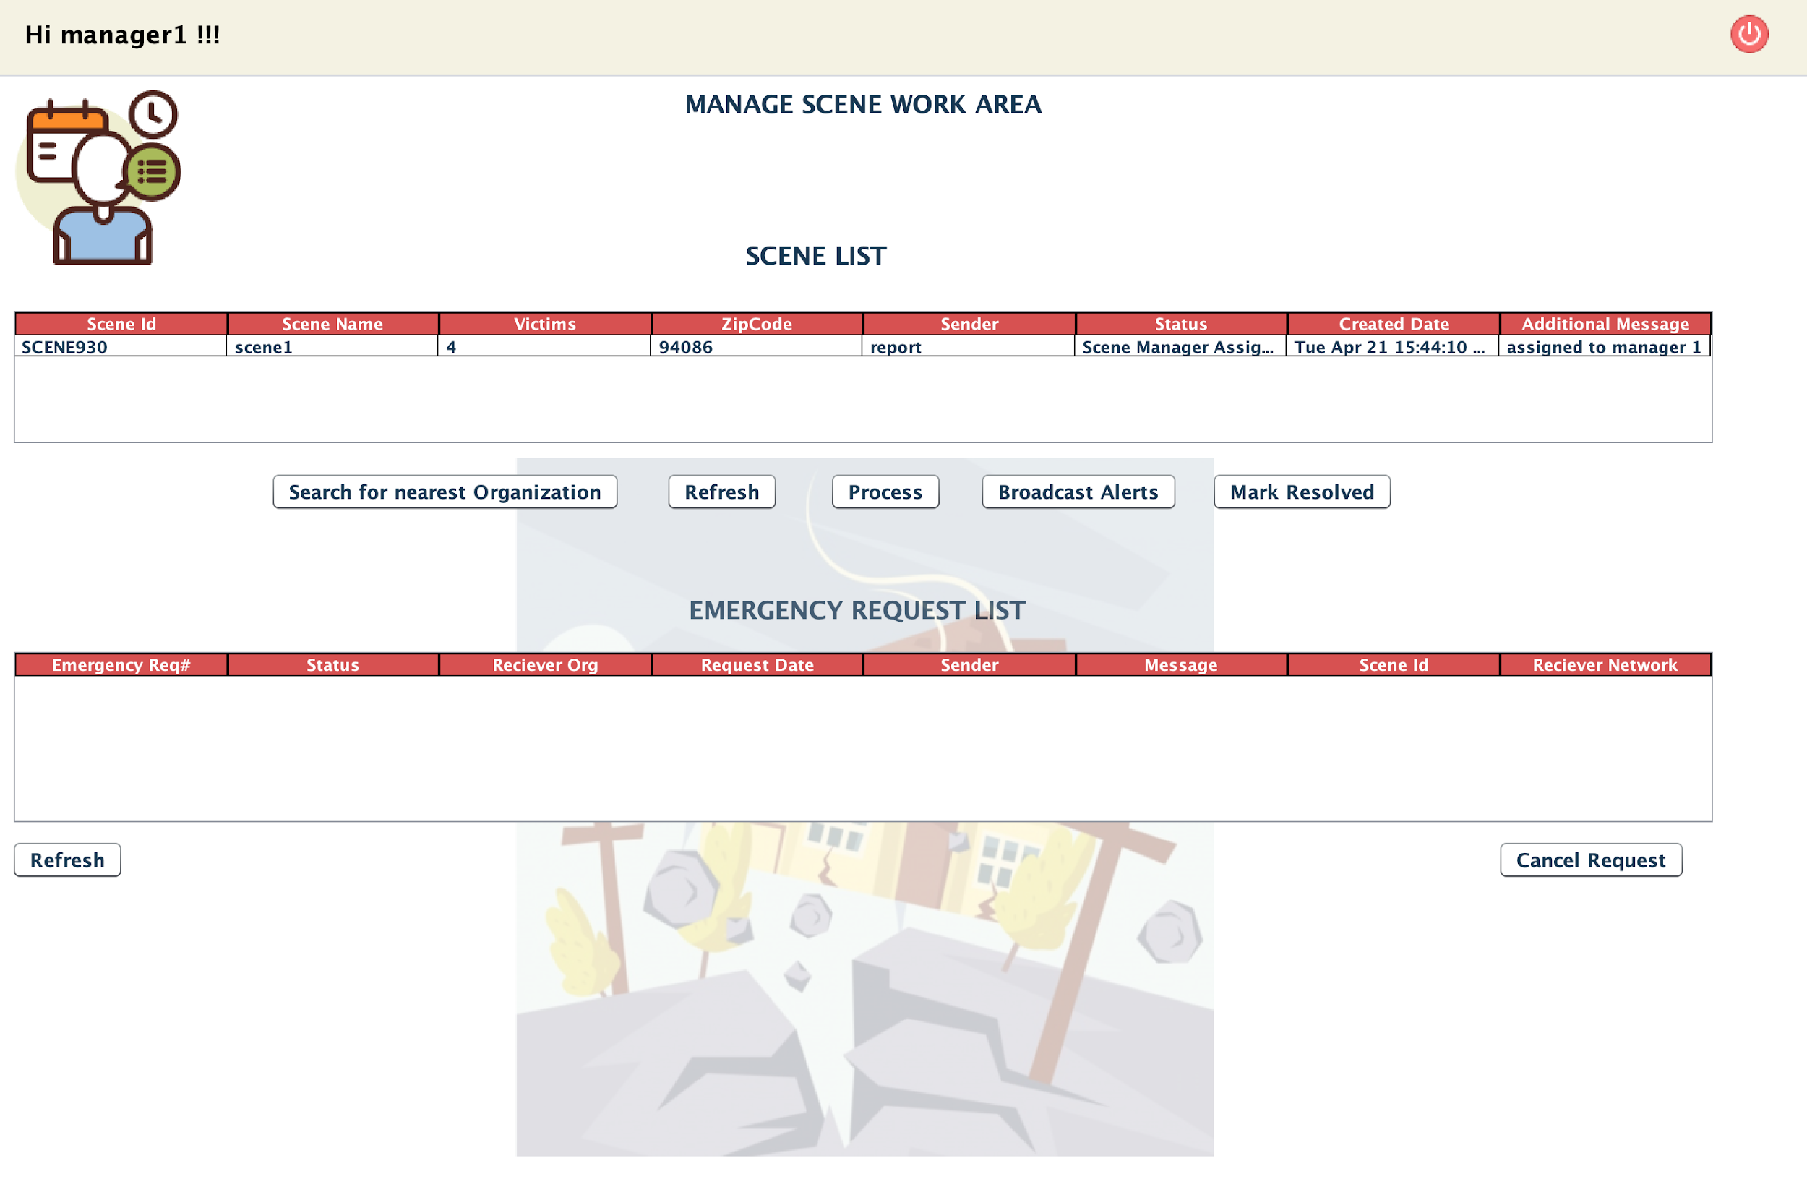
SCENE MANAGER LOGIN ABLE TO SEE ACTIVE SCENE
Place your screenshot here

Slide 51
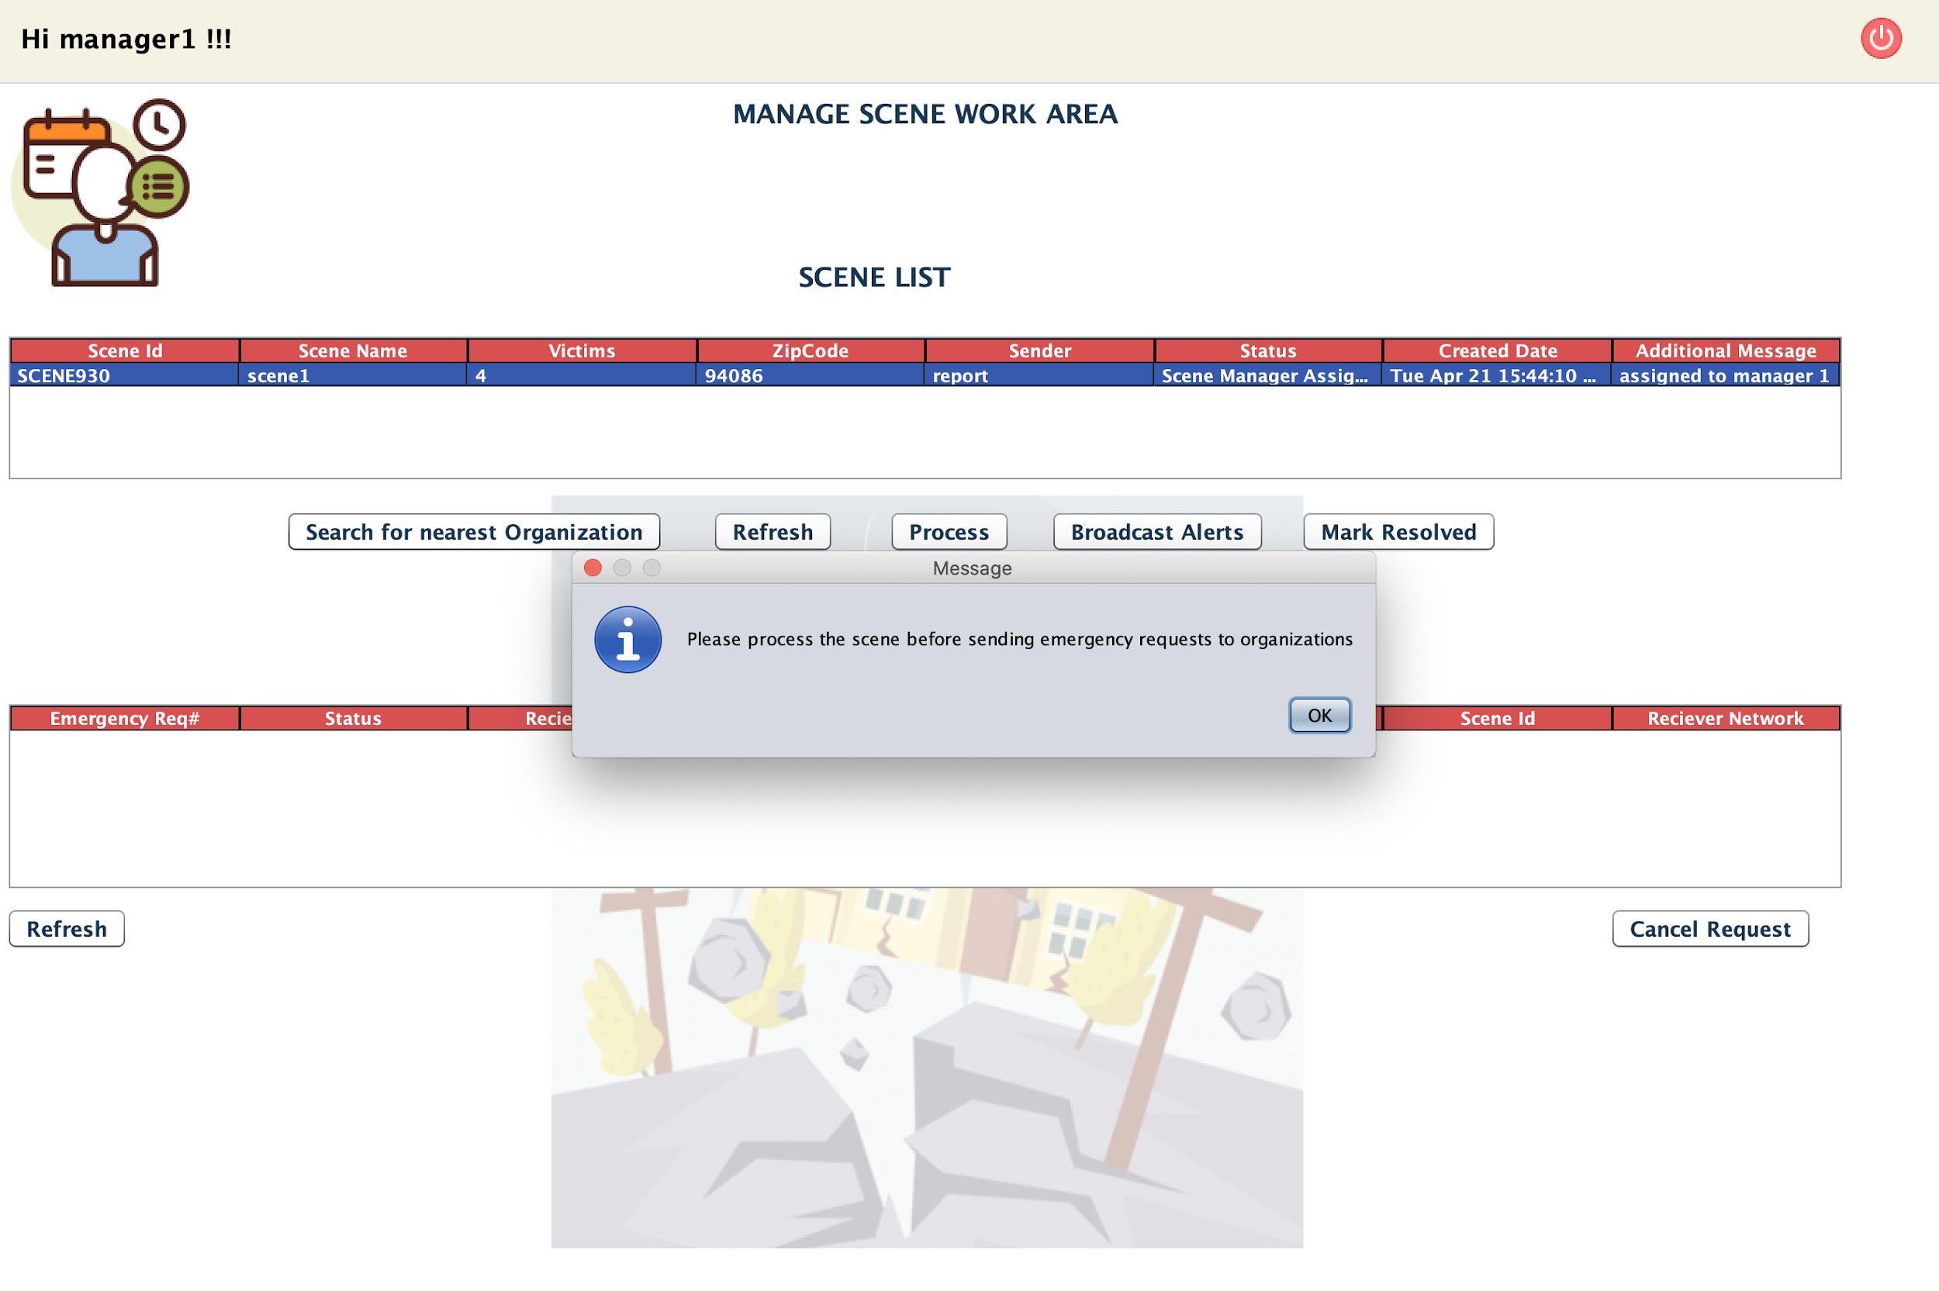
SCENE MANAGER FIRST NEEDS TO SET STATUS IN PROCESS IN ORDER TO VIEW NEAREST ORGANIZATION
Place your screenshot here

Slide 52
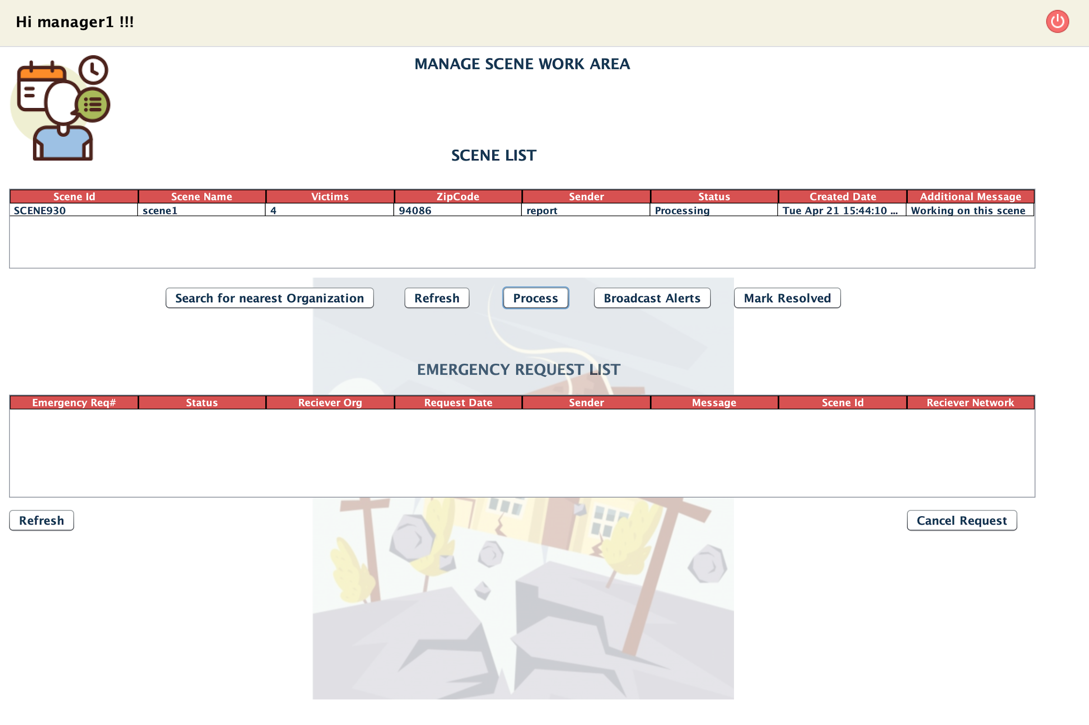
SCENE MANAGER:
WORK REQUEST STATUS CHANGED TO PROCESSING
Place your screenshot here

Slide 53
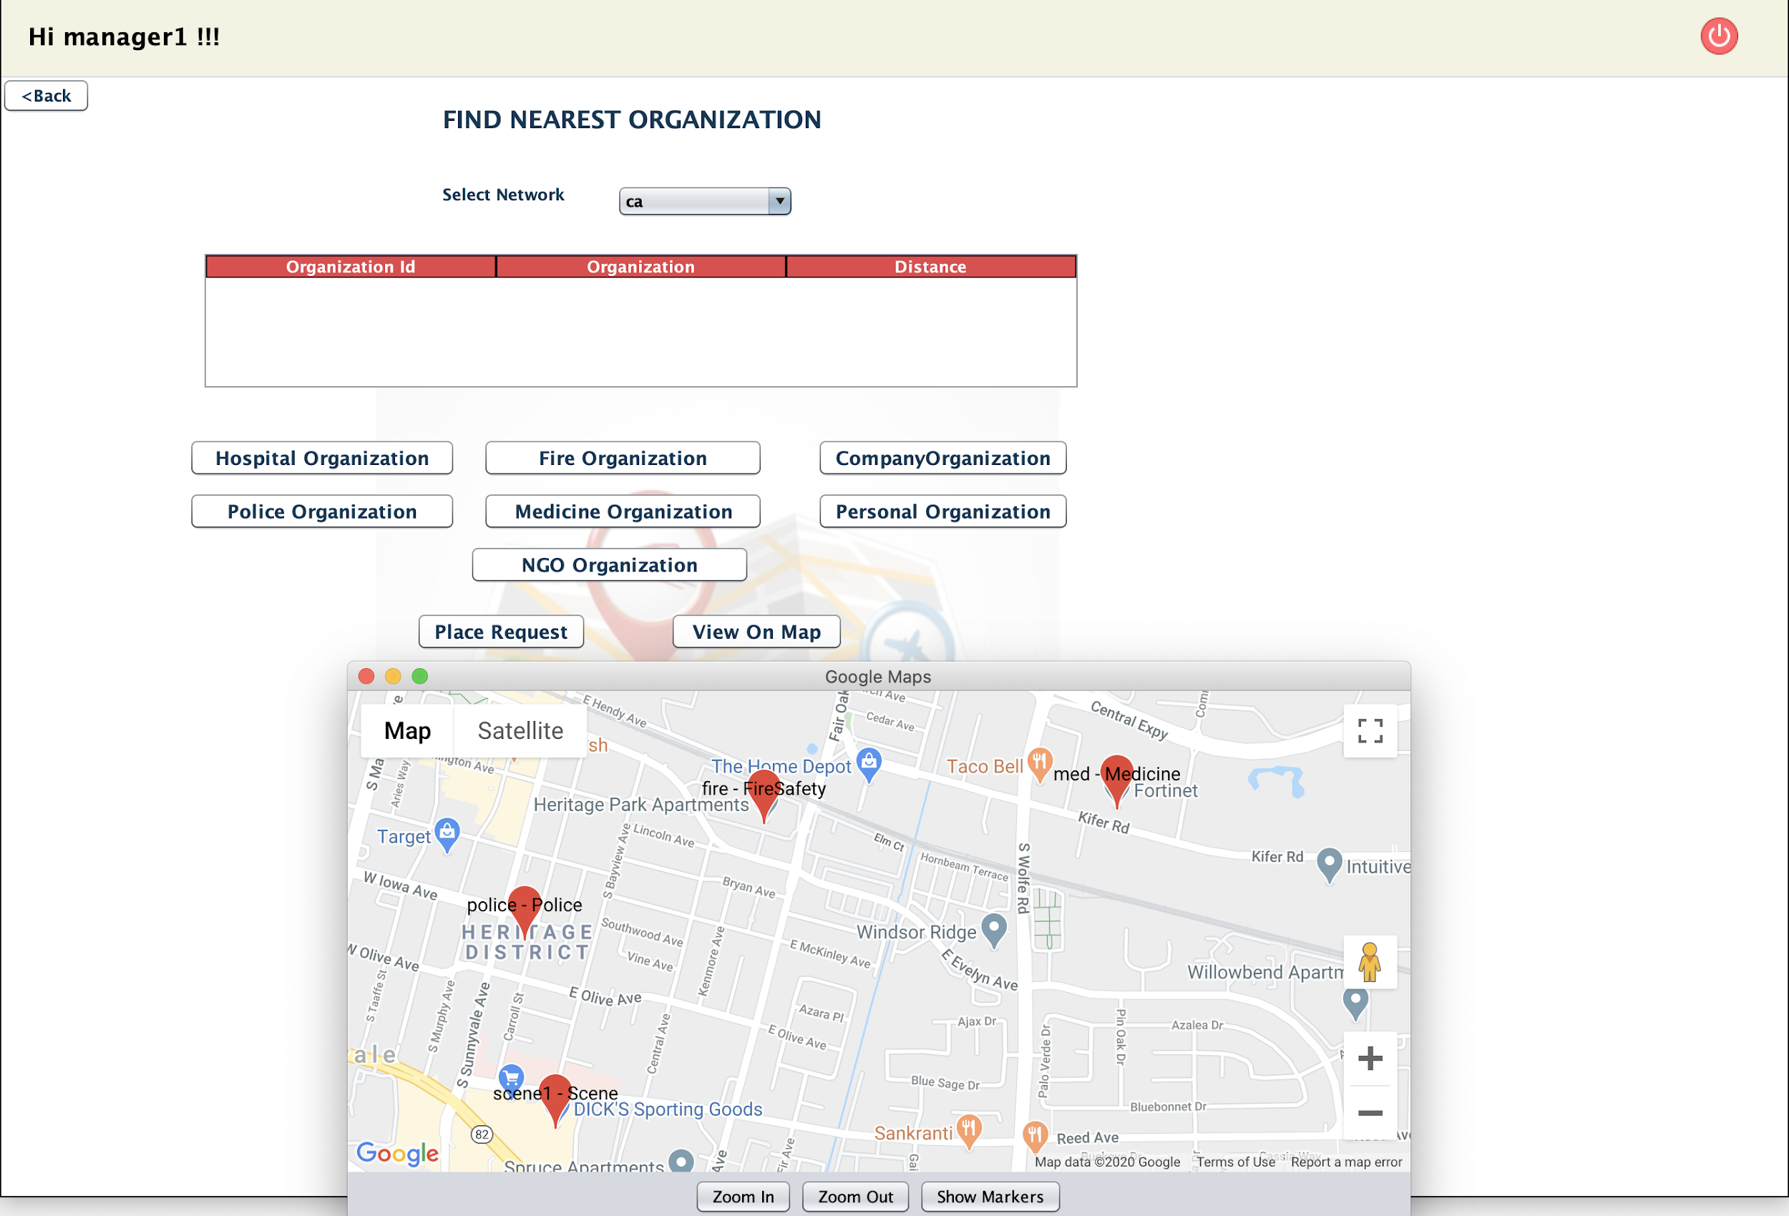
SCENE MANAGER CAPABILITIES :
ABLE TO SEE NEAR BY ORGANIZATIONS
Place your screenshot here

Slide 54
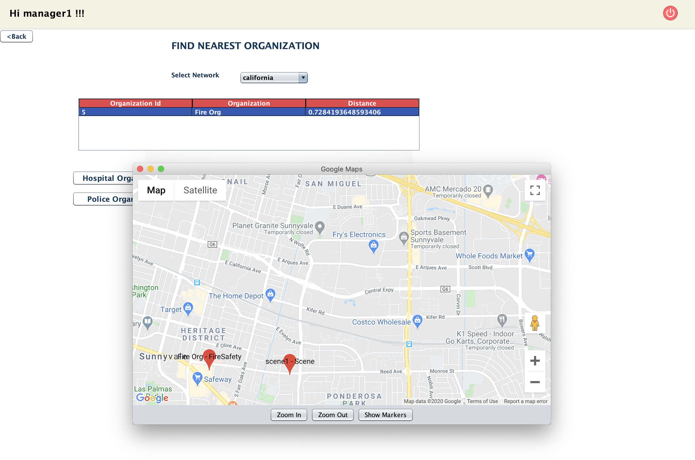
SCENE MANAGER CAPABILITIES : ABLE TO SEE NEAR BY SELECTED ORG
Place your screenshot here

Slide 55
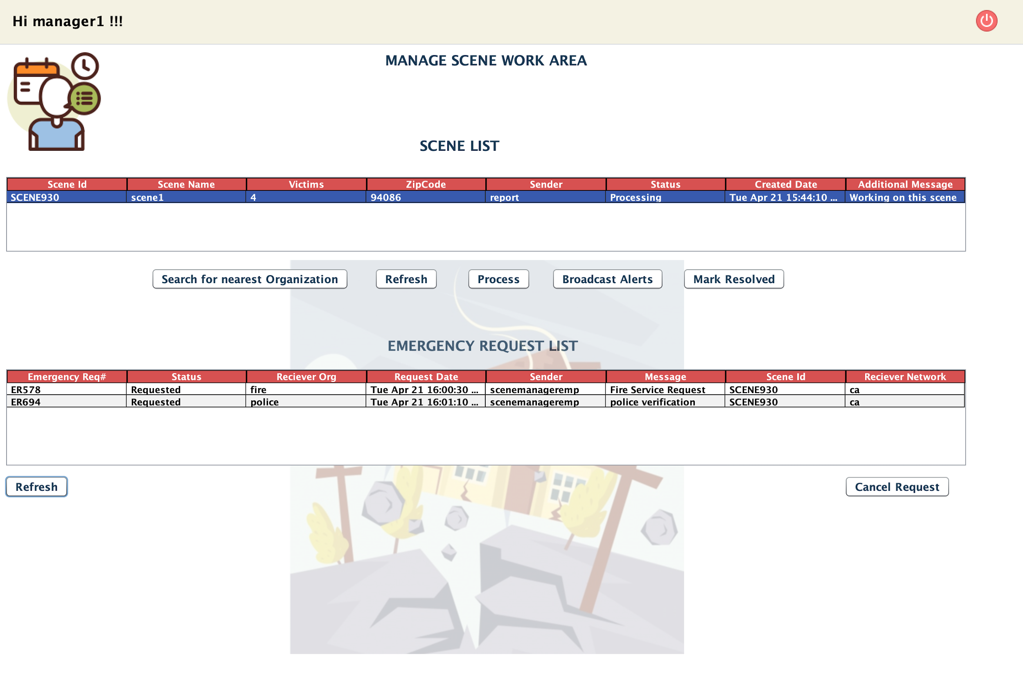
SCENE MANAGER CAPABILITIES :
Able to send Work Request to Multiple organization and Enterprise and Cross Network
Place your screenshot here

Slide 56
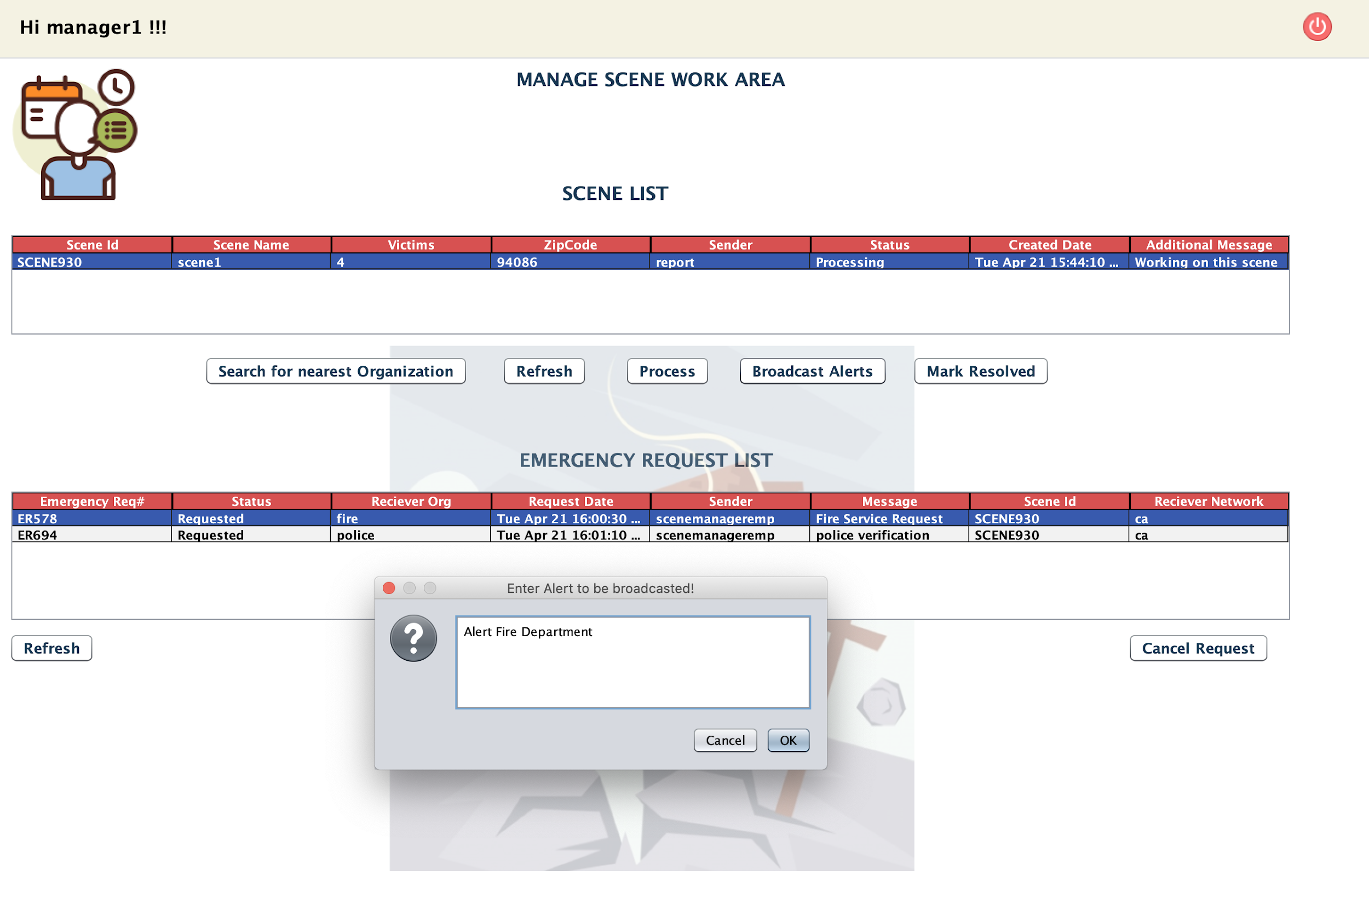
SCENE MANAGER CAPABILITIES:Able to send notification to the Organizations
Place your screenshot here

Slide 57
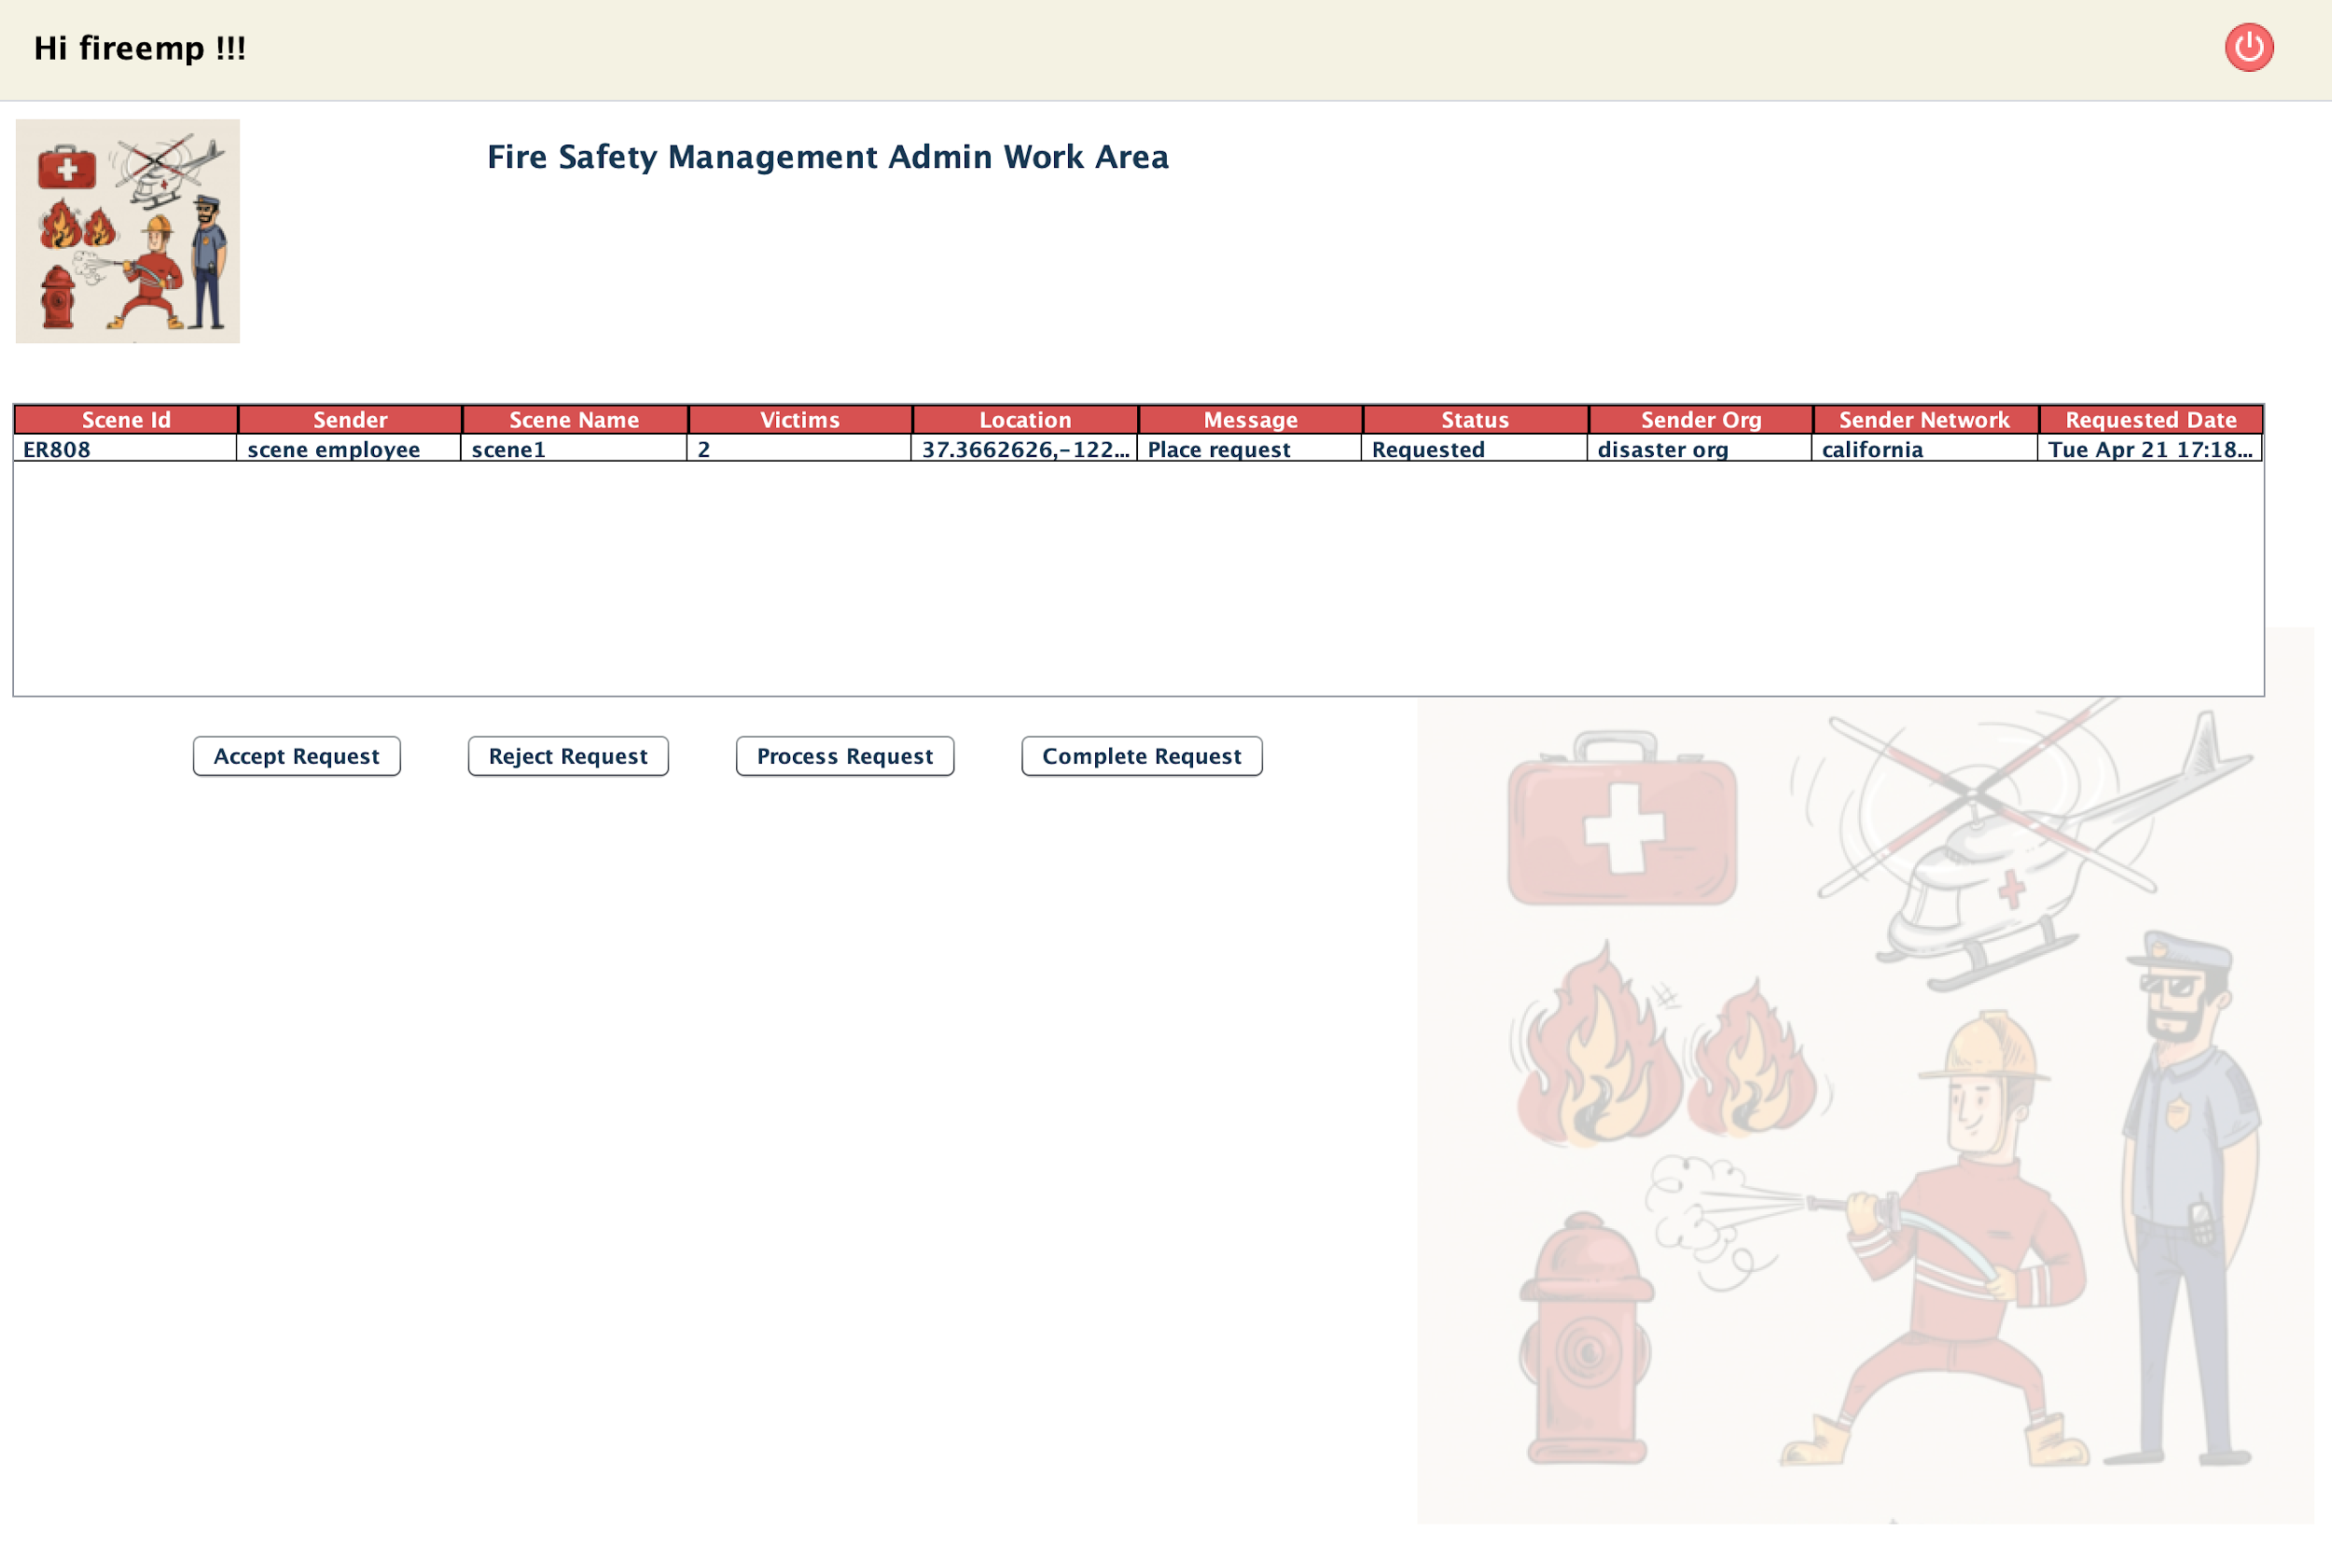
FIRE ORG ABLE TO LOGIN AND ABLE TO SEE WORK REQUEST
Place your screenshot here

Slide 58
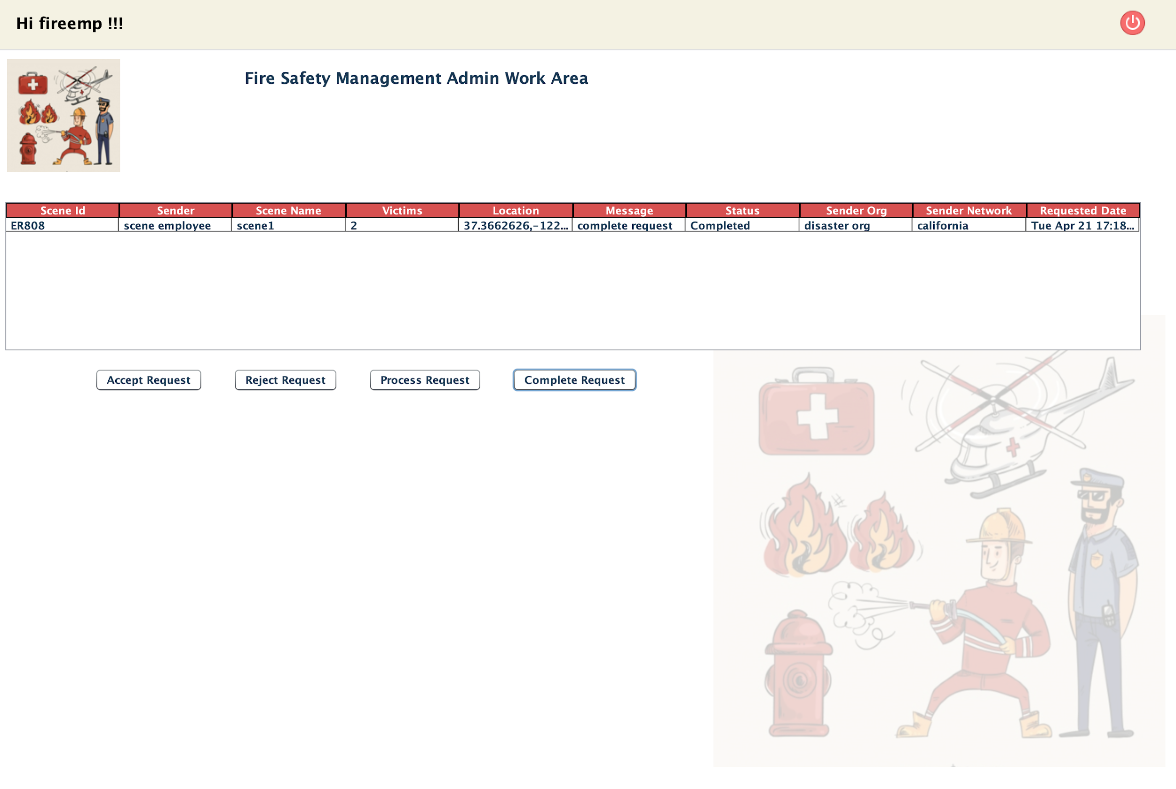
FIRE ORG COMPLETES REQUEST
Place your screenshot here

Slide 59
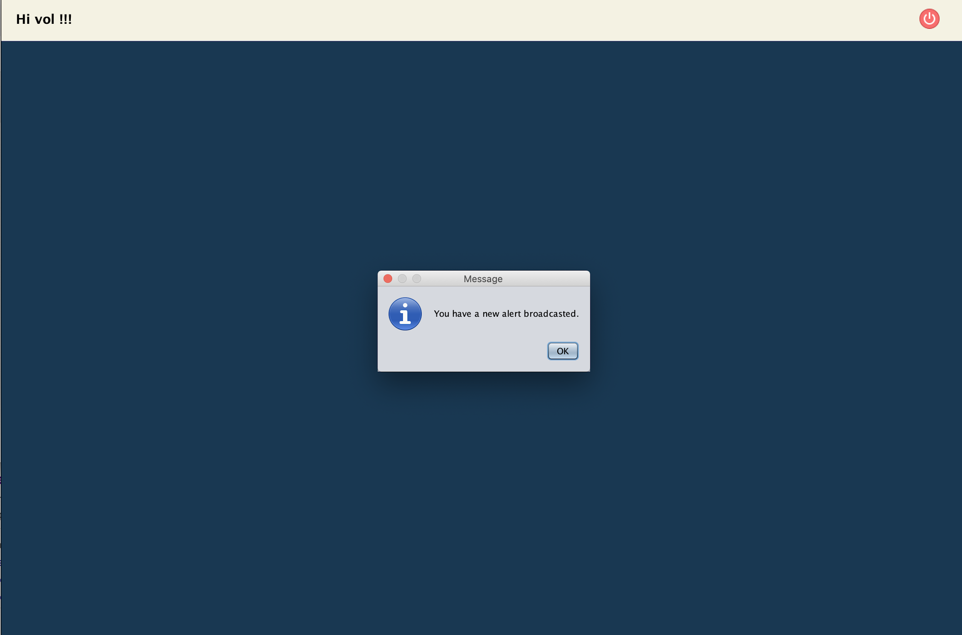
Voluntary Enterprise - All Organization able to see broadcasted message
Place your screenshot here

Slide 60
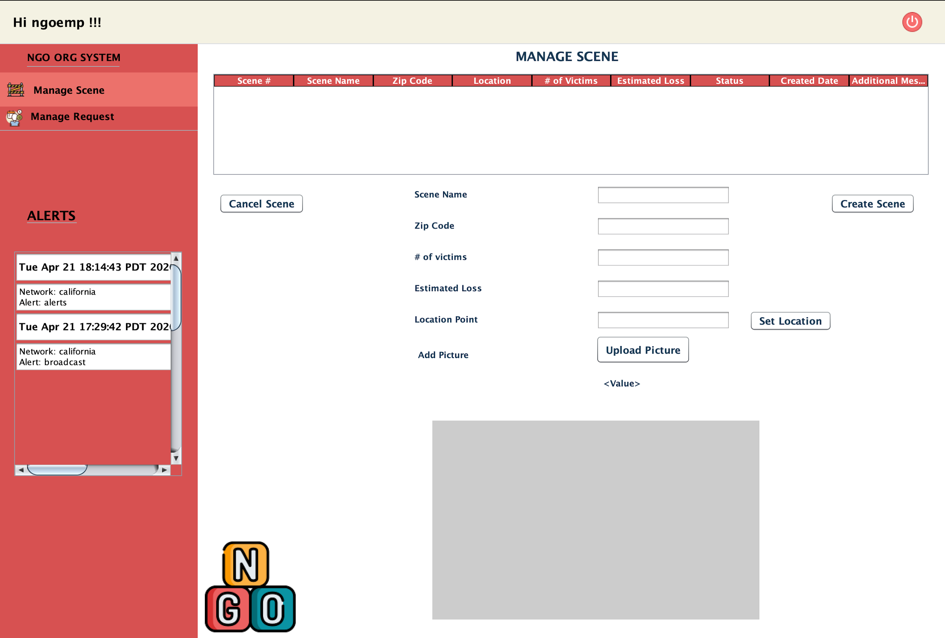
NGO ORGANIZATION ALERTS
Place your screenshot here

Slide 61
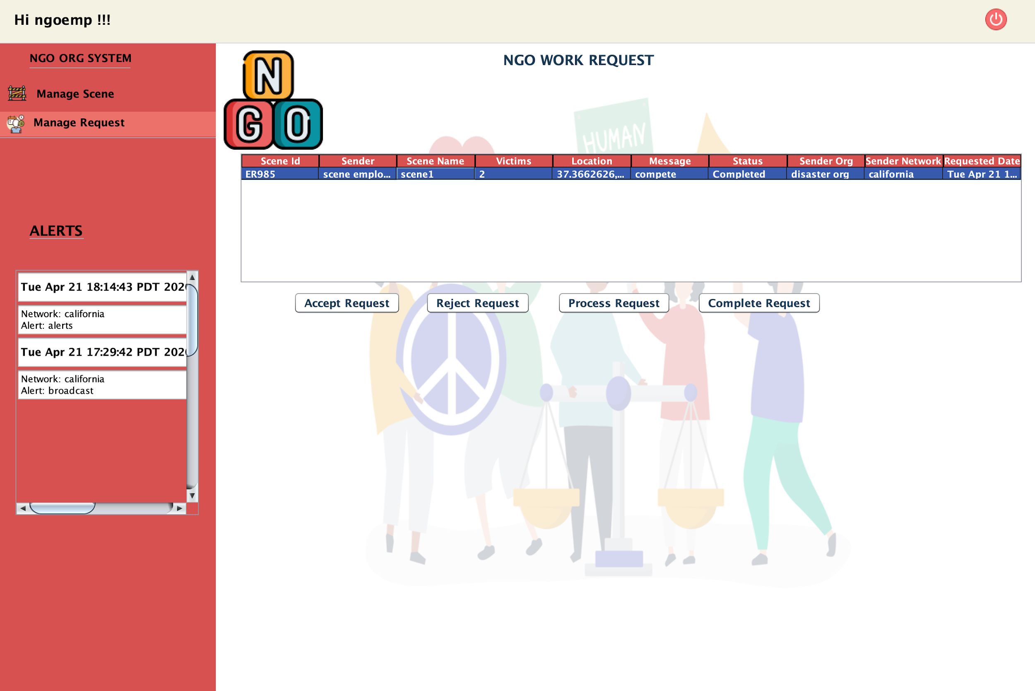
NGO ORGANIZATION COMPLETES WORK REQUEST
Place your screenshot here

Slide 62
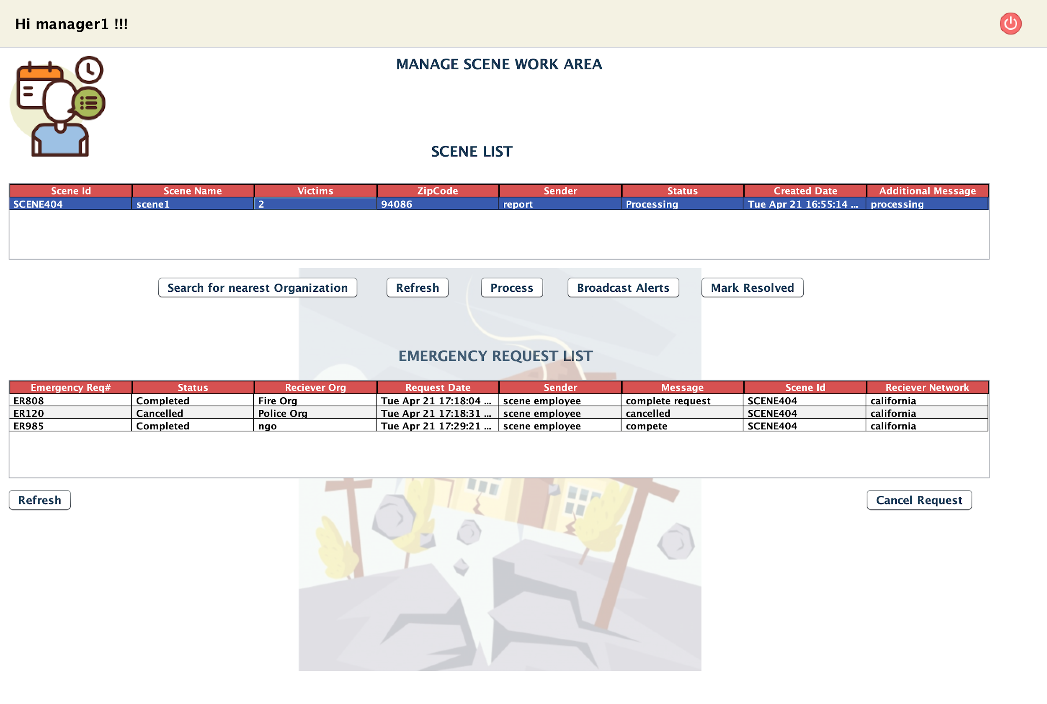
SCENE MANAGER ABLE TO SEE ER# STATUS
Place your screenshot here

Slide 63
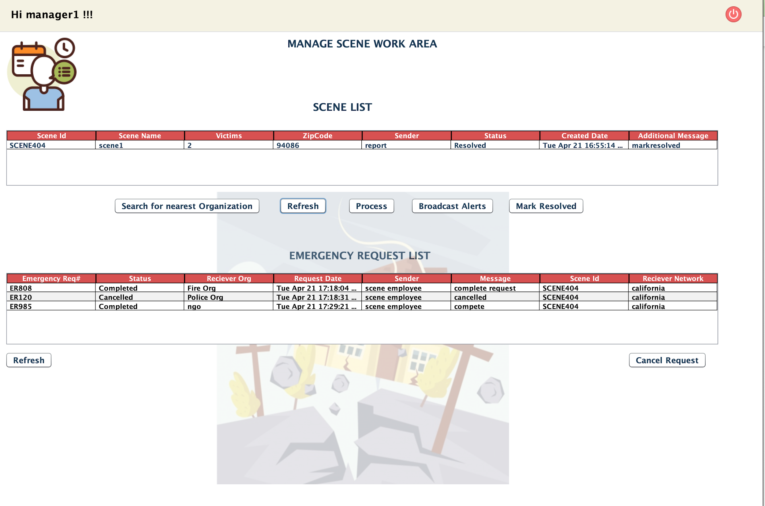
SCENE MANAGER RESOLVED THE CASE
Place your screenshot here

Slide 64
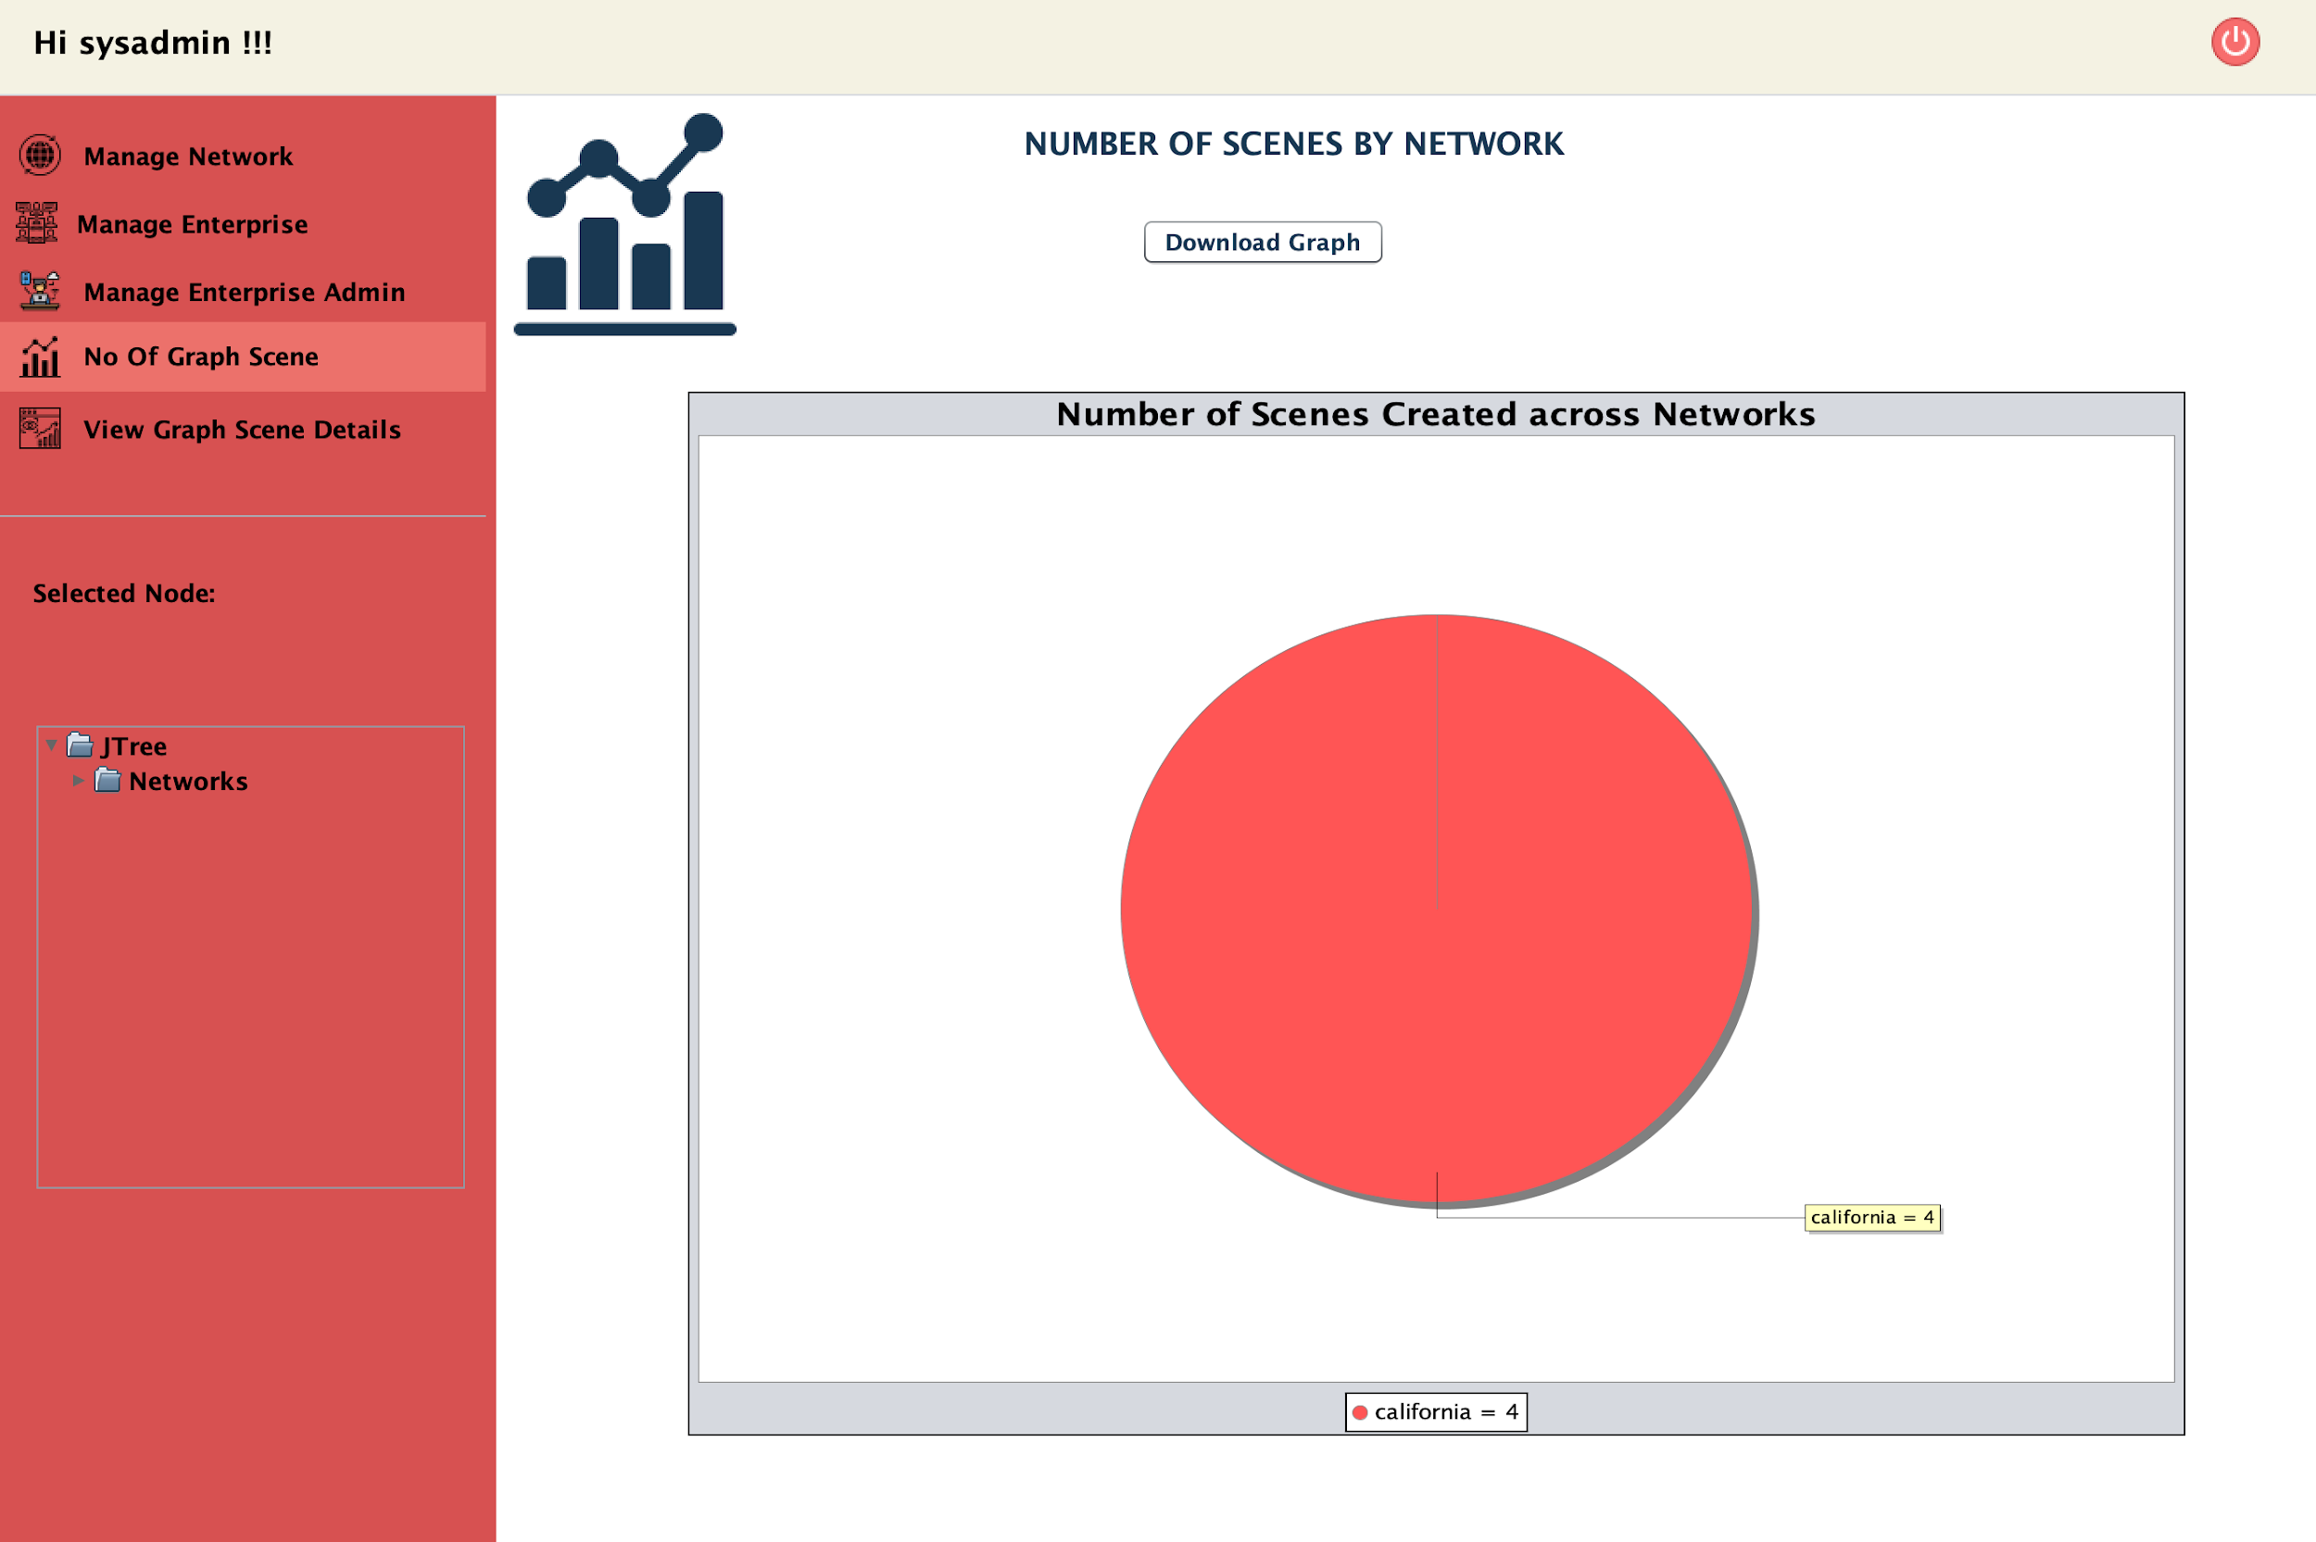
GRAPH : Number of Scene By Network
Place your screenshot here

Slide 65
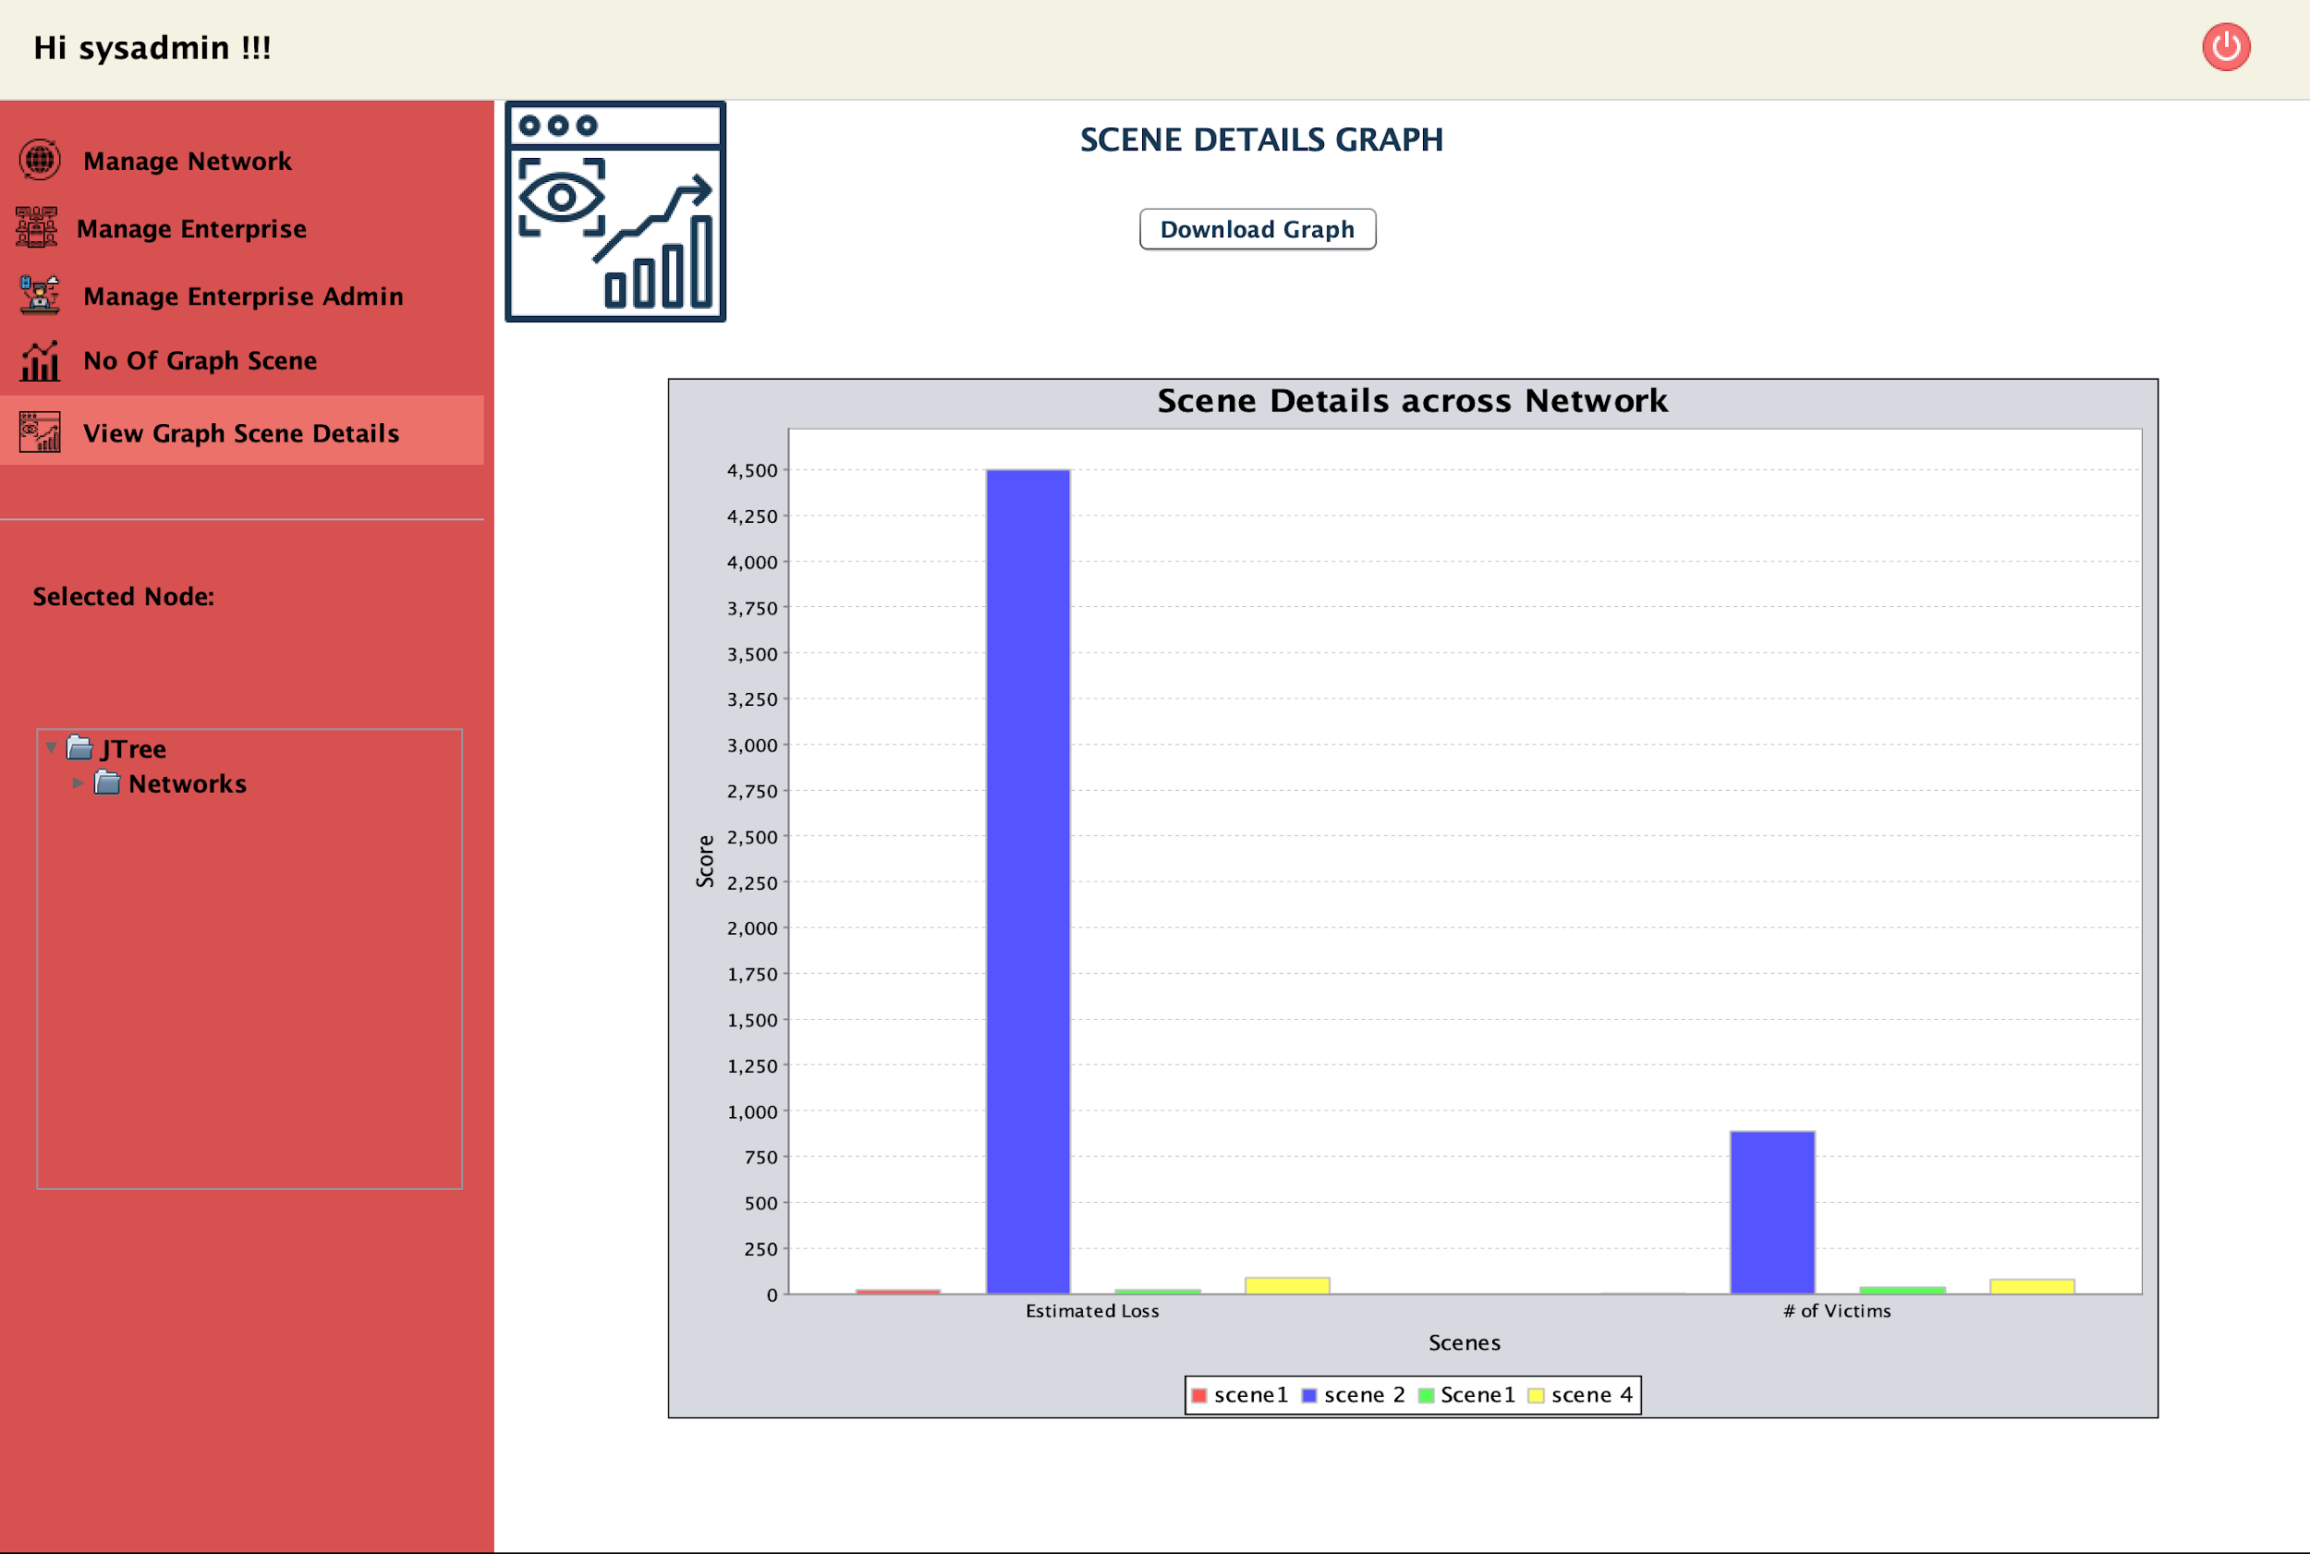
GRAPH : Scene Details Across Networks
Place your screenshot here

Slide 66
Thanks!
Any questions?
You can find us at:
bhatt.s@husky.neu.edu
deshpande.m@husky.neu.edu
sisodiya.d@husky.neu.edu

